Slide 1
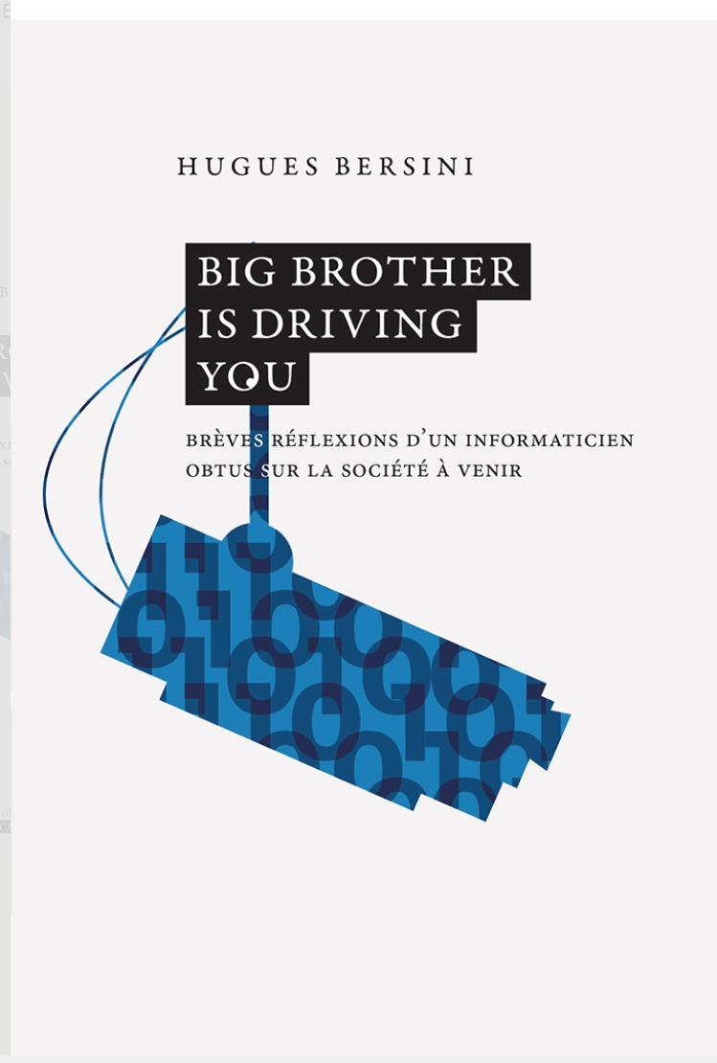

Algocracy,
FARI and smart cities

Slide 2

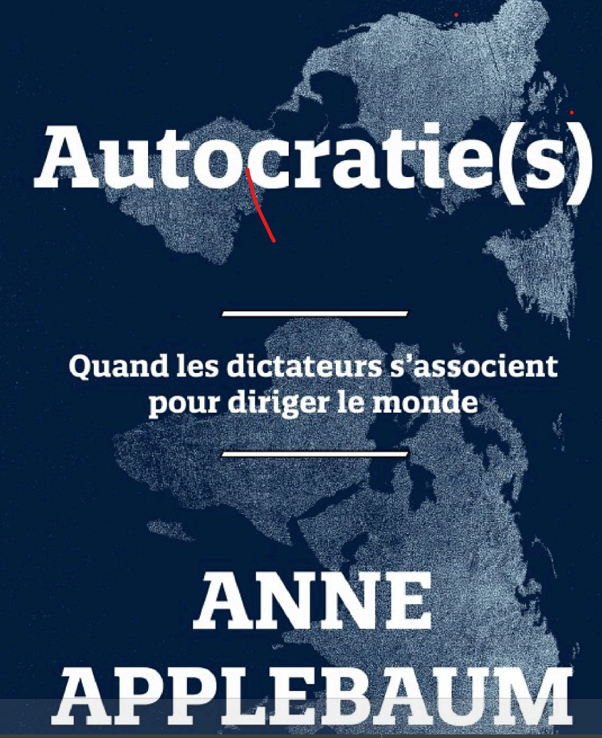



Slide 3
Plan
Under algorithmic influence
  Algorithms that recommand
  Algorithms that oblige
How to legitimate their use:
  Criticisms
  Citicode (Citoyens Hackers)
FARI:
  Some projects

Slide 4
Under algorithmic control

Slide 5
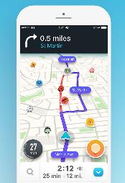




Algos that recommand

Slide 6
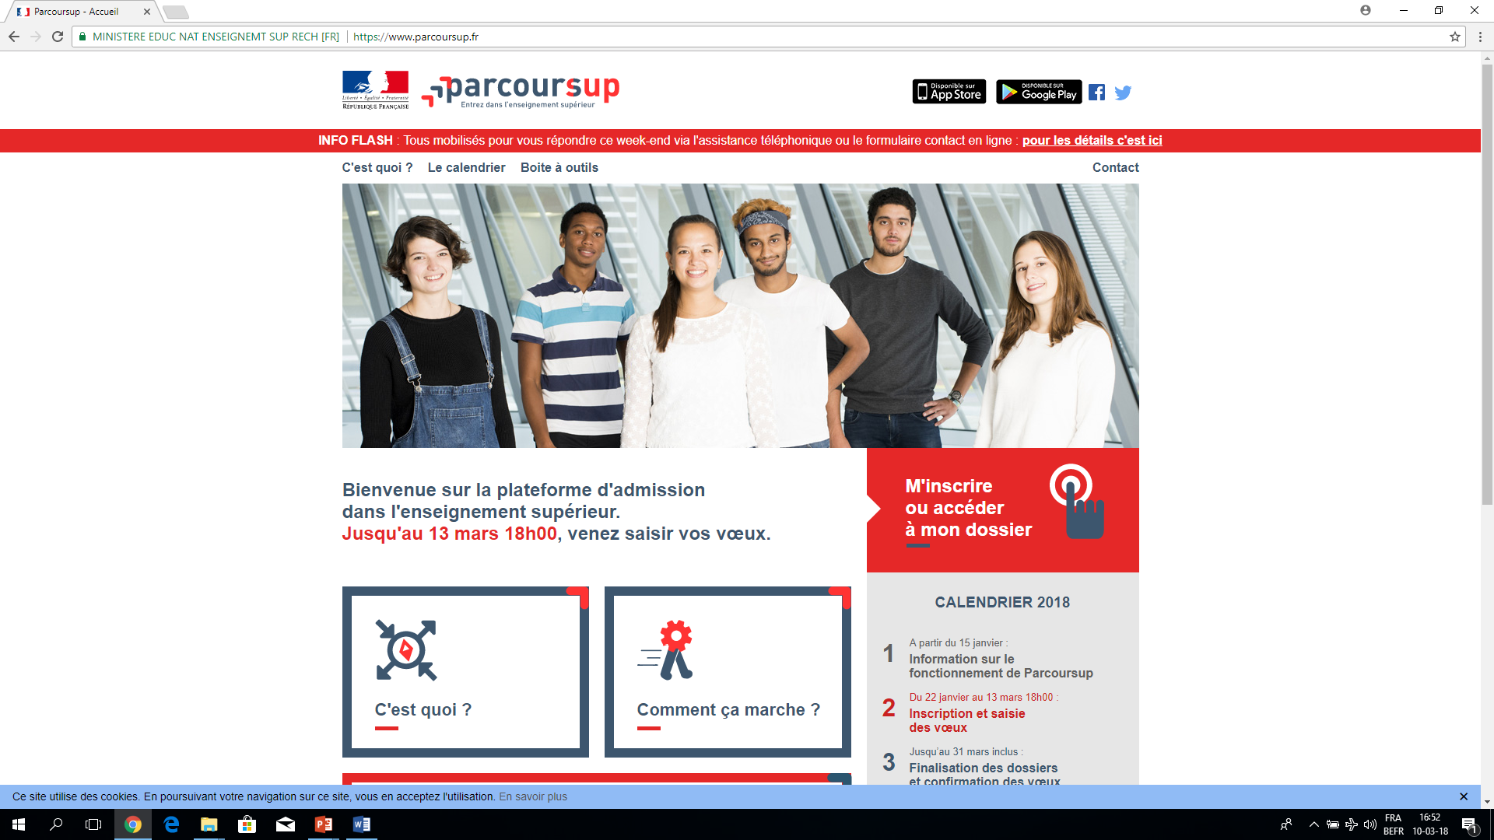



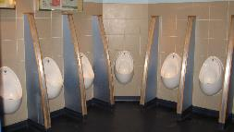
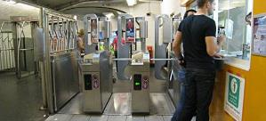

Algos that oblige

Slide 7


Slide 8

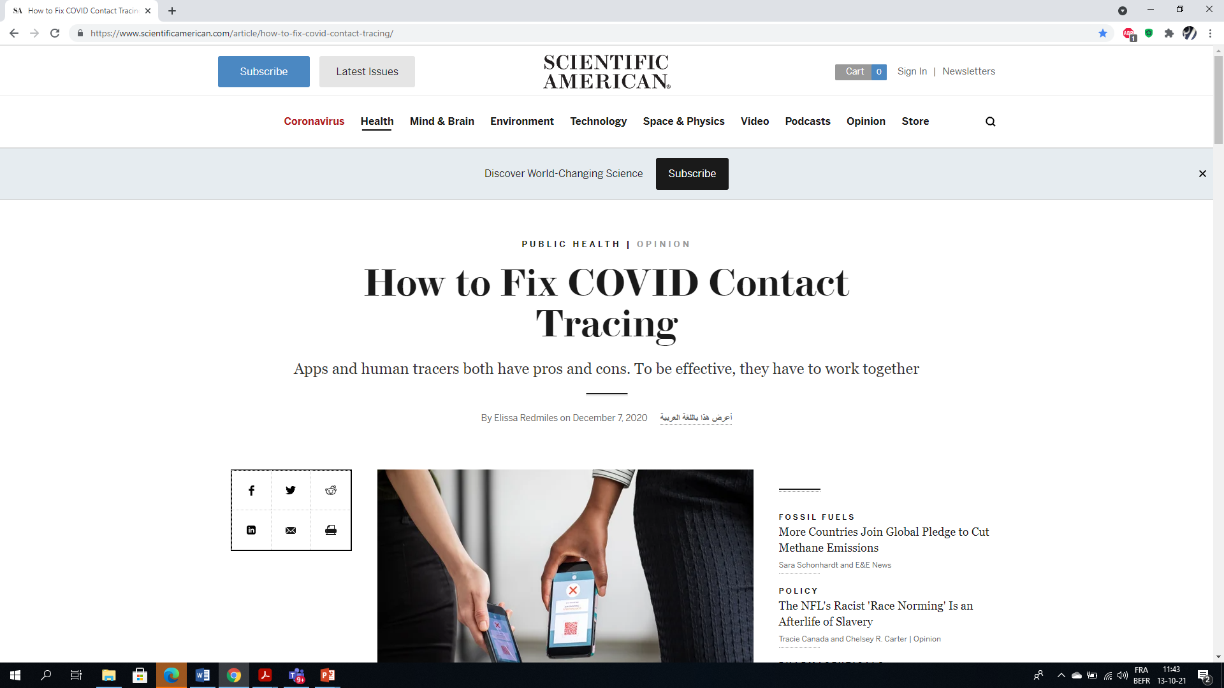
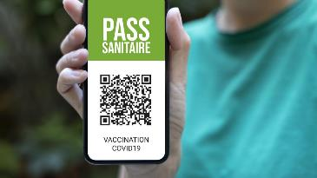
Covid
No transparency
No efficiency
No citizen partecipation
No agility
No adhesion success

Slide 9
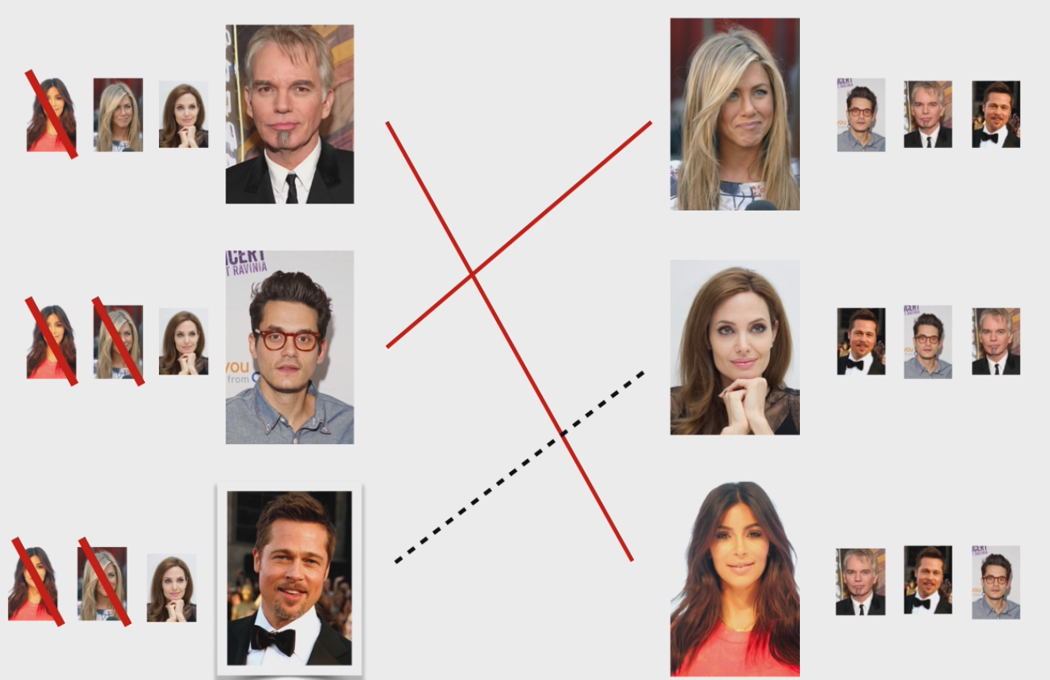
Gale-Shapley for
ParcourSup,
DECRET INSCRIPTION and Covid Testing

Slide 10
FRENCH ParcourSUP or Belgium Decret Inscription
The stable marriage
or
Gale-Shapley algorithm
to match
students to universities

Slide 11
Three groups of developpers
1. Experts in algorithmic, in law, and in the domain in question in a github way
2. Citizens randomly selected among those who are interested
3. Politicians elected for this specific domain of interest to resolve ideological conflicts

Slide 12


Slide 13
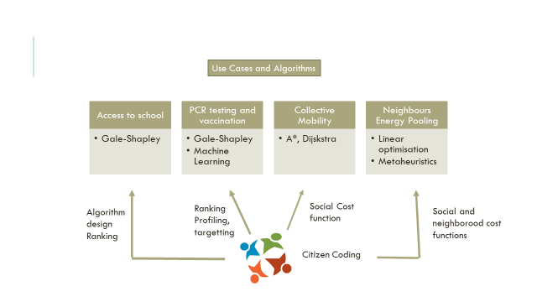

Slide 14
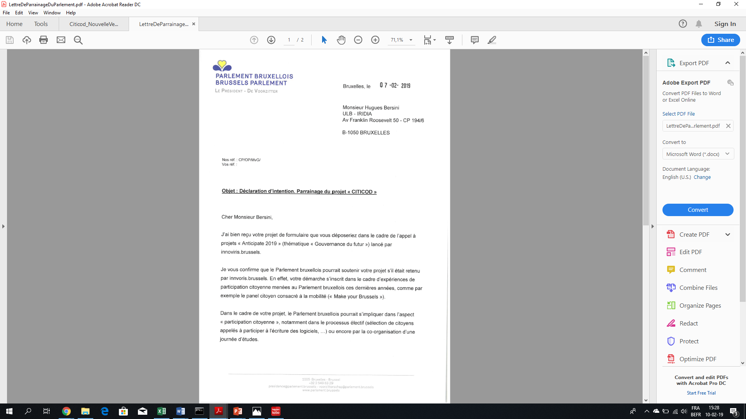
THE CITICOD PROJECT
FOR THE « DECRET INSCRIPTION »

Slide 15
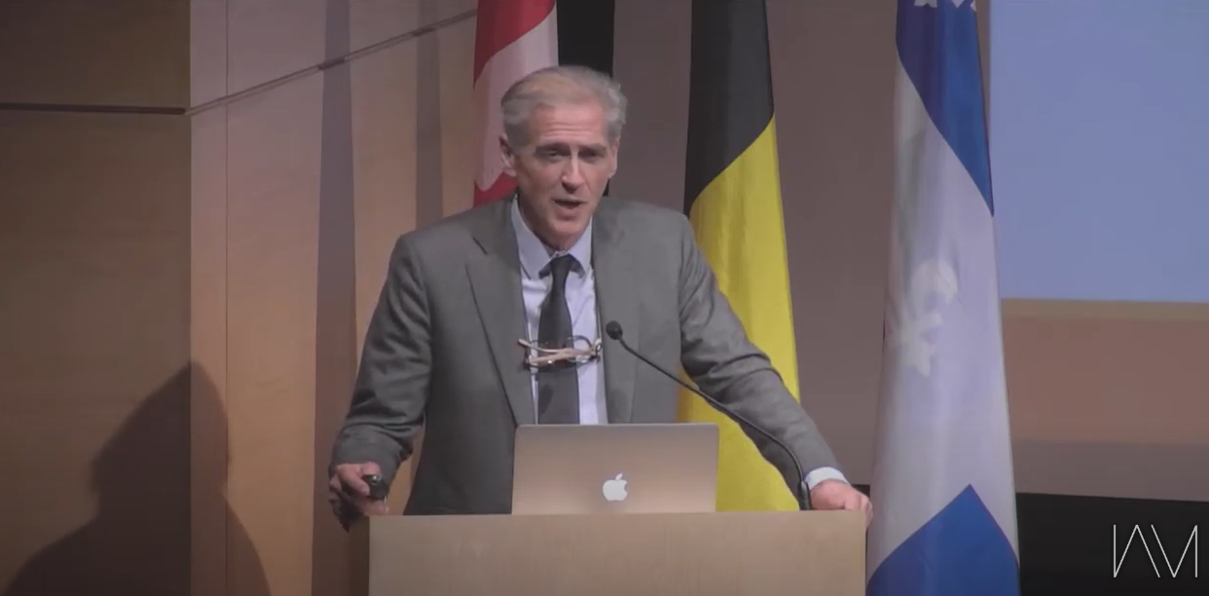

fari

Slide 16
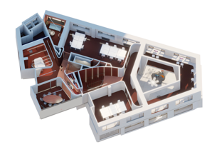
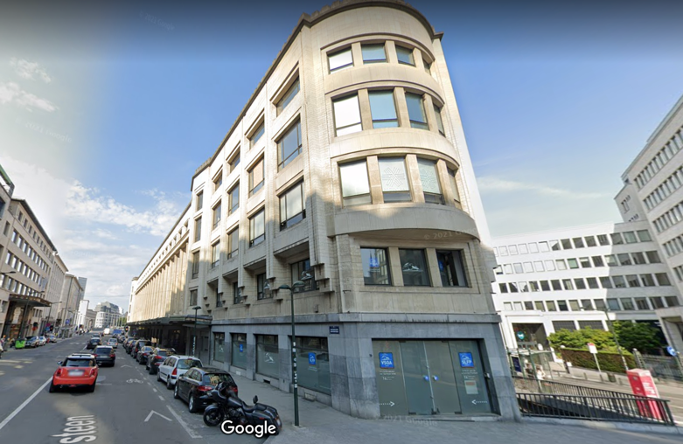
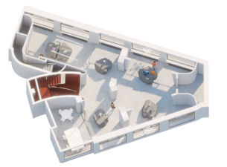
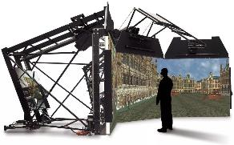
Key infrastructure
The FARI Test and Experience Center (600m2)
A place where +15 demonstrations on AI, data, robotics and ethics showcase these technologies and their potential impact.
In this space, events are organized to meet private, public, civic and scientific actors.

Slide 17



Green deal
Ethical AI
Health & Wellbeing
Energy
Mobility
Media / Democracy
Public Sector & Administration (Gov)

Slide 18
The Covid crisis and possible software assistance: The exemple of contact tracing
No transparency
No efficiency
No citizen partecipation
No agility
No adhesion success

Slide 19
Contact tracing apps were imagined and developed by technology companies
with little input from public health experts or the public the apps are designed to serve.
When tech companies impose technologies in domains
they do not understand, they often fail
If contact tracing apps continue to fall short on adoption
as the surge of cases increases, now is perhaps the time for big tech
to remember that they need to listen to the public health experts these apps attempt to replace,
and the public that has failed to adopt this new technology.

Slide 20
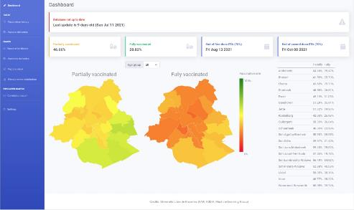
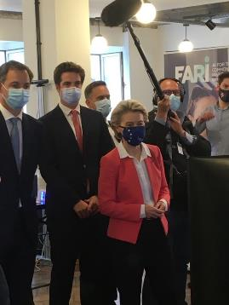
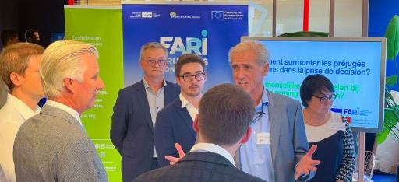
The existing FARI developments for Brussels Vaccination

Slide 21
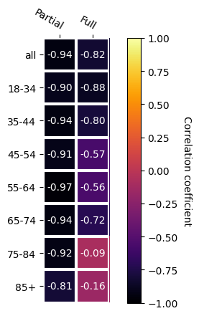
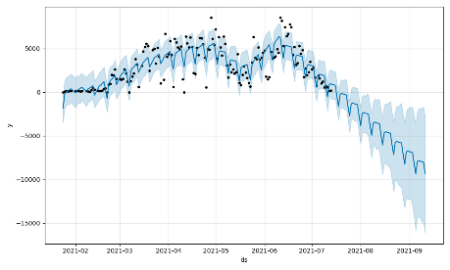
Correlation unemployment-vaccination

Slide 22

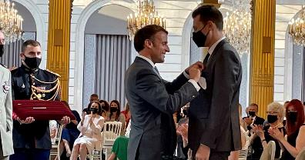

Slide 23
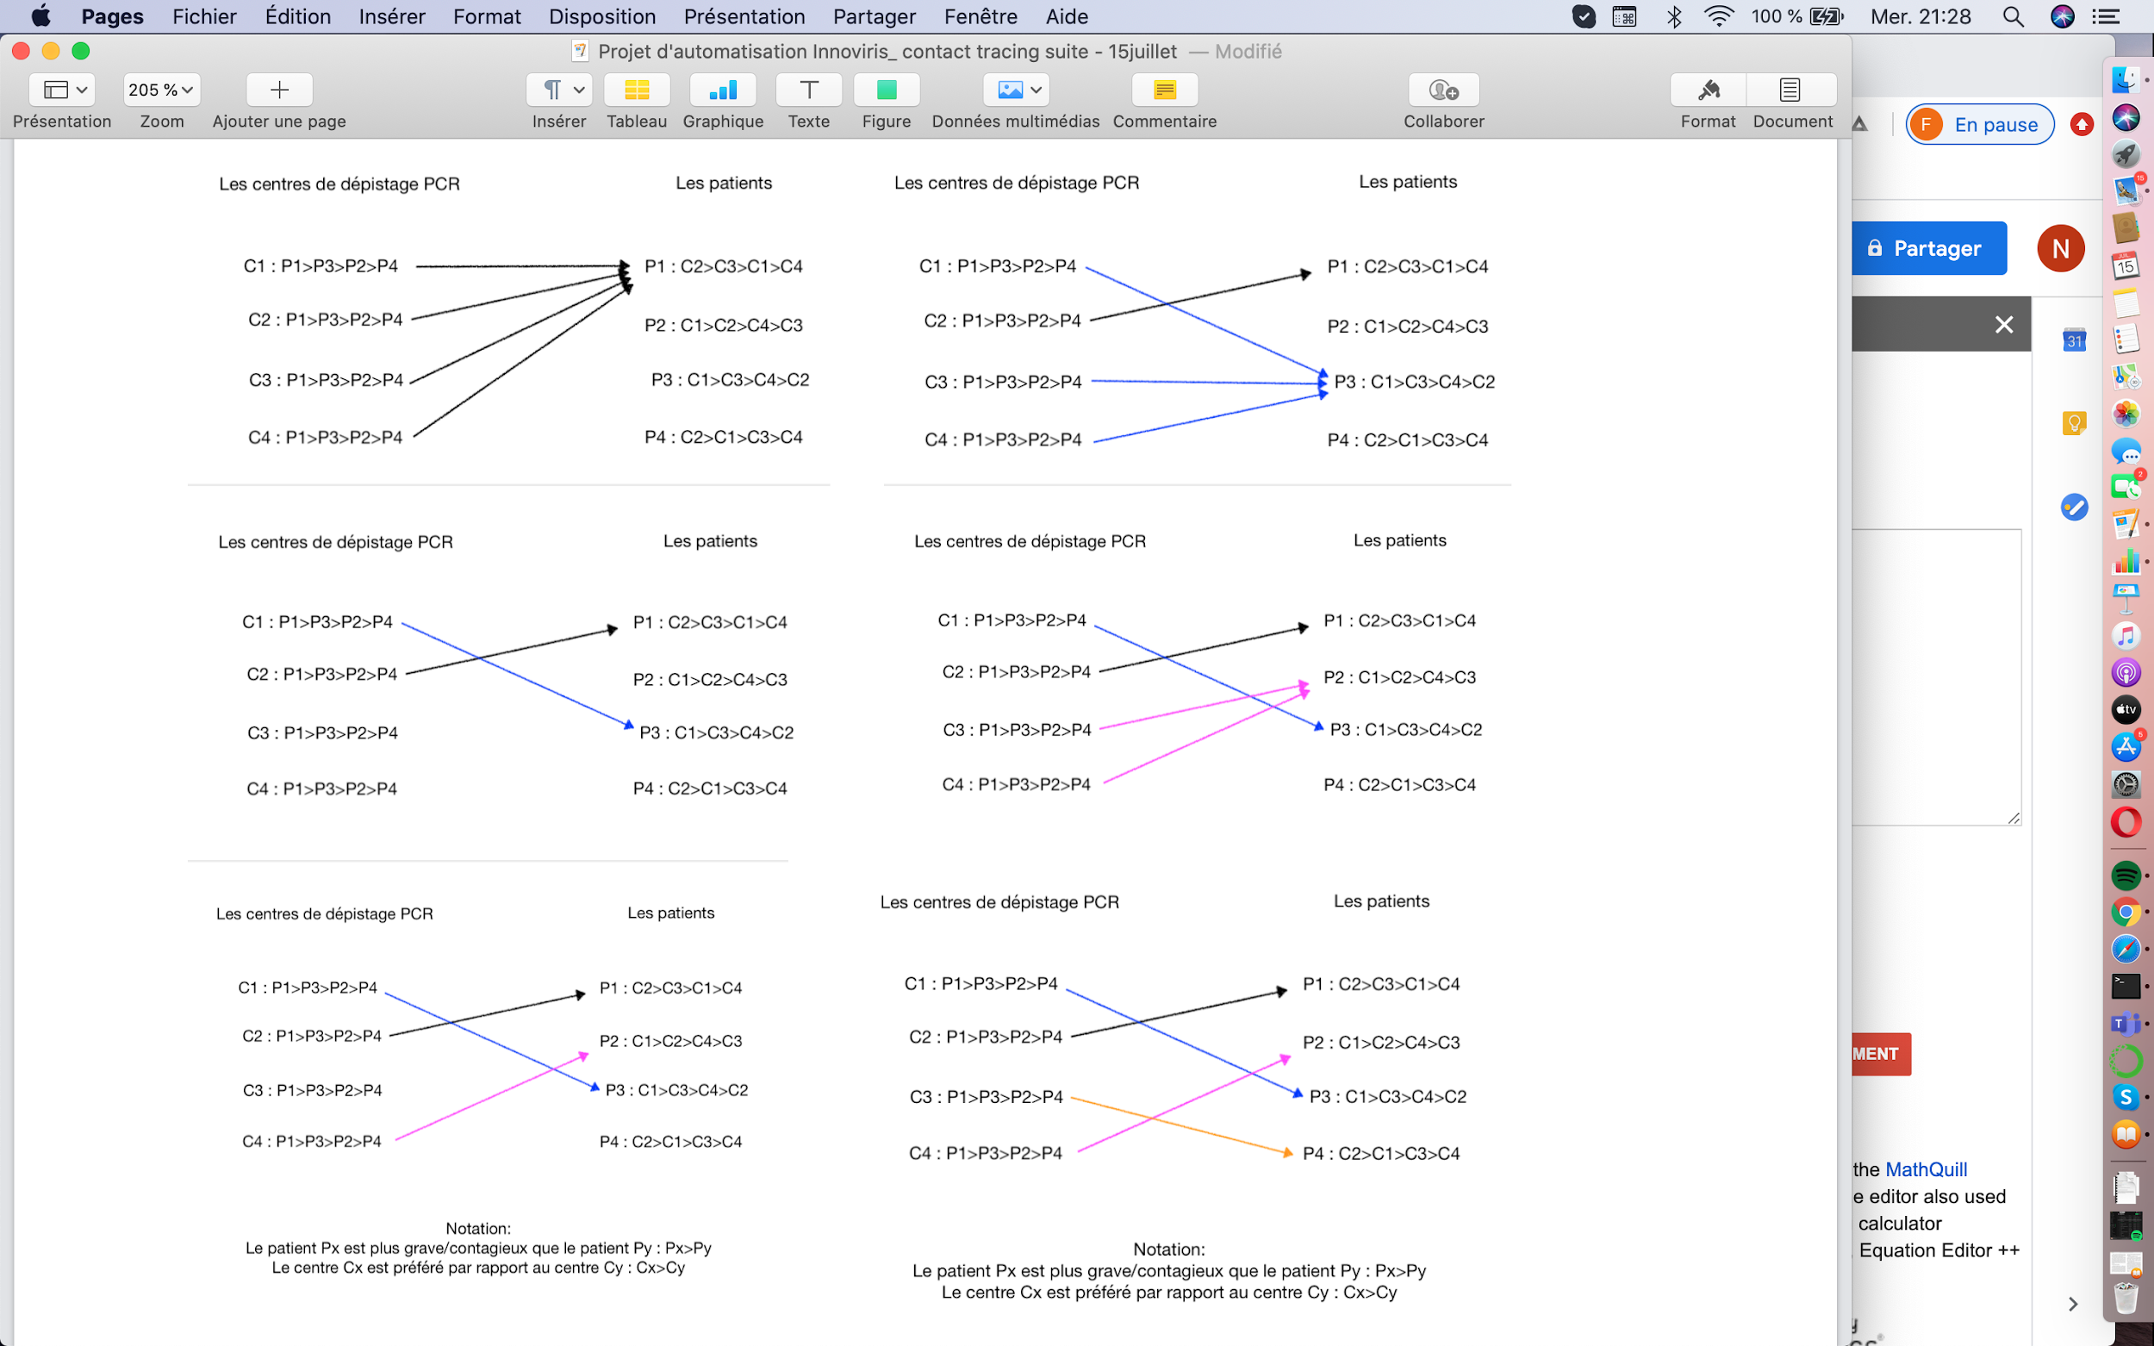
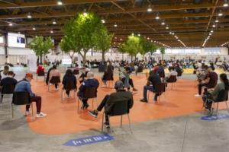
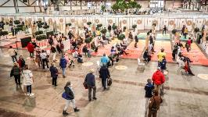
A new vaccination strategy: Matching between the patients and the testing/vaccination center

Slide 24
Other potential projects
In mobility as a service
To help local administrations in charge of employment
Consulting citizens to implicate them in the design of AI systems

Slide 25
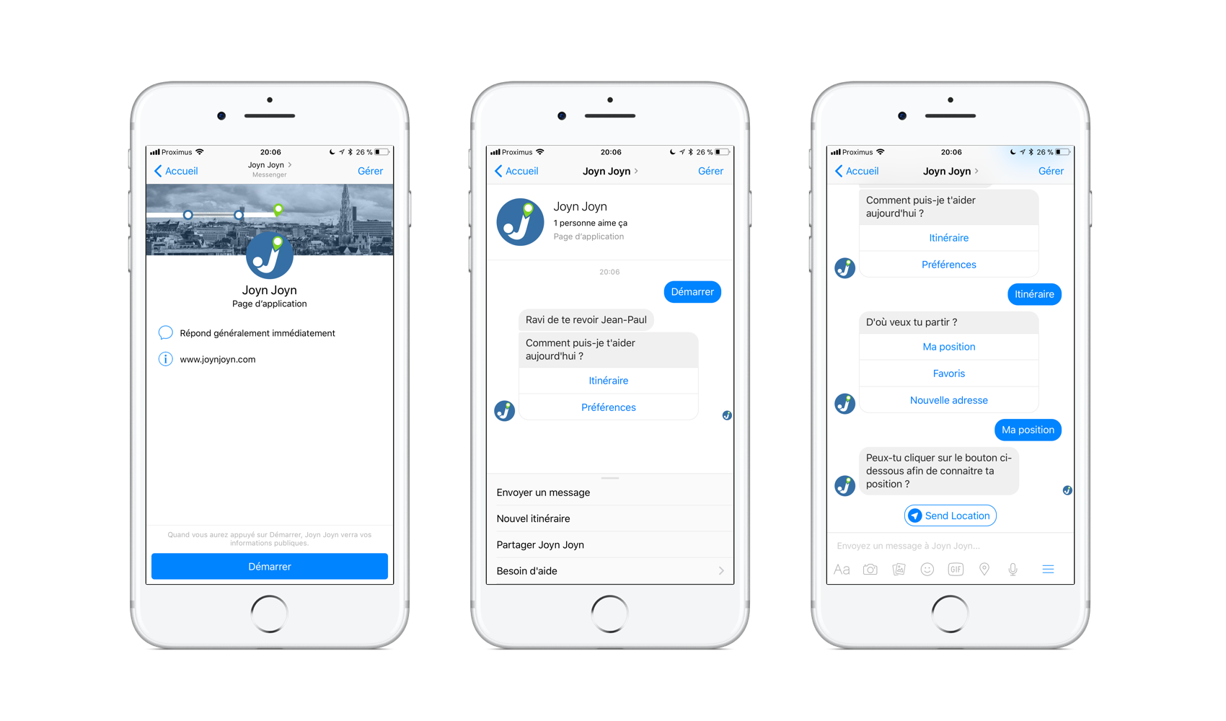
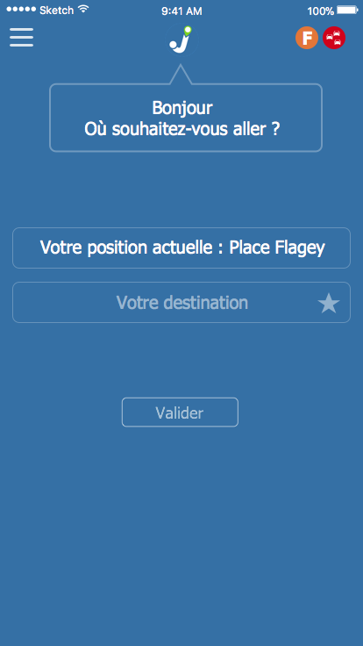
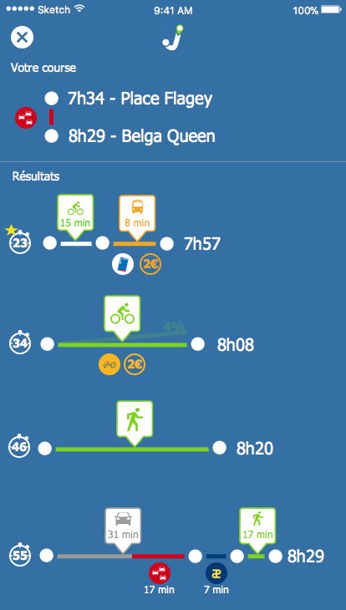
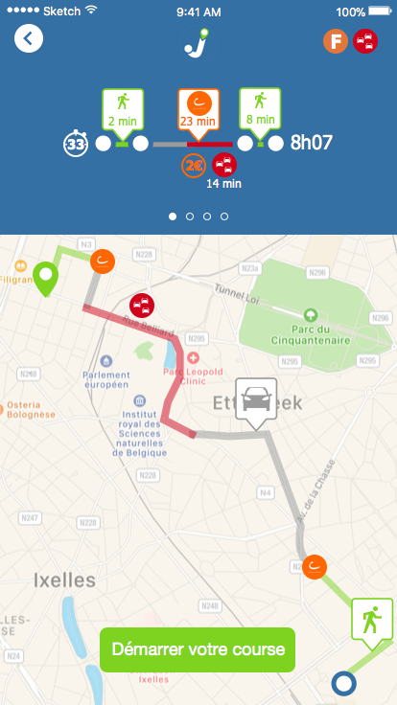

Mobility as a Service

Slide 26


Slide 27
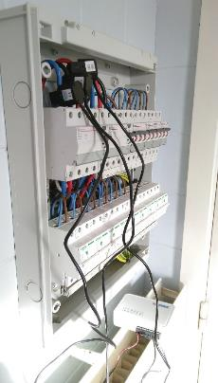
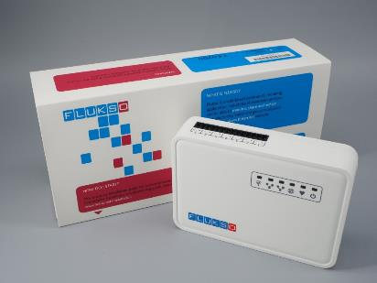
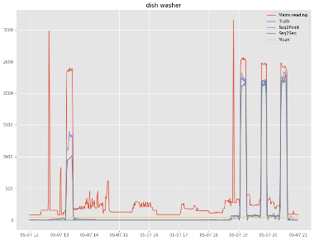
Retrofit homes with smart electricity meter

Slide 28
Bridge between public institutions, industry, research and citizens
Industry
Research
Public
institutions
Civil Society
FARI

Slide 29
A young institute …
1983
2021
2023
2025
Start of AI Lab in Brussels
Launch of FARI (ULB&VUB)
Opening Test & Experience Center
Comprehensive service offering
2022
2024
first FARI annual conference
Launch of AI Academy
Opening of the CAVE
July 2021
first FARI annual conference
Funded mainly by Recovery & Resilience Facility
Funded mainly by FEDER/EFRO

Slide 30
… built upon 40 years of previous research
1983
Start of AI research in Brussels
2021
2023
2025
Launch of FARI (ULB&VUB)
Opening Test & Experience Center
Comprehensive service offering
40 years of previous experience
2022
2024
first FARI annual conference
Launch AI Academy
Opening of the CAVE
July 2021
first FARI annual conference

Slide 31
FARI is based in Brussels, in the heart of the city, close to public institutions, industries and people
Core values
  Safeguarding
  Transparency
  Safety
  Sustainability
Brussels Region
1km
European Parliament
Brussels Central Station
FARI
Brussels Parliament
Federal Government
Brussels Government
VUB/ULB

Slide 32









10 affiliated research groups across VUB & ULB
Central Team

Slide 33
FARI’s interdiciplinary team help tackle all new challenges
With a wide range of skills

Slide 34
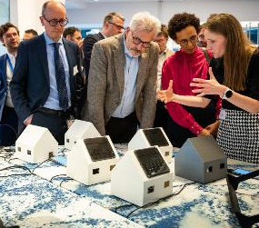
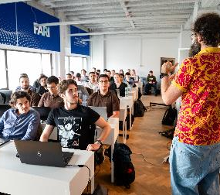
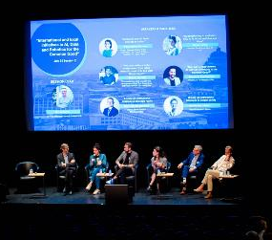
Our 3 branches allow us to build knowledge and practical solutions and share them
Research and innovation
Training and Services
Building a Community of practice

Slide 35
FARI Chairs on our flagship programs
Trust
Cities
Public
Sustainability
Health
Designing and deploying AI, robotics or data analysis systems responsibly to ensure they operate securely and reliably, while complying with legal regulations and ethical guidelines.
Using AI, Data and Robotics to enhance urban livability and resilience—improving infrastructure, services, and data-driven insights to make cities more efficient, inclusive, and enjoyable for residents.
Exploring AI’s role in the public sector—how it affects citizens’ daily lives, aids policy and decision-making, and transforms governance. This includes responsible delegation of tasks to AI and understanding its societal implications.
Creating systems that minimize environmental and social impact from the outset: embedding sustainability into design, measuring and quantifying outcomes (e.g., data-center energy use).
Improving global health through better data access and utilization—streamlining health-record management, enhancing practitioners’ decision-making, and advancing public-health responses via comprehensive data collection and analysis.

Slide 36
Training & Service Portfolio
GET A TASTE
LEARN
EXPERIENCE
APPLY
GO BEYOND
Teaser sessions
Catalogue sessions
Coaching
Applied learning
Expertise brokerage
Customised visits
Customized teaching
Guidance & Consultancy
Applied expertise
Contract Research
AI Academy
Services
R&D

Slide 37
Nous identifions les besoins des utilisateurs, développons et affinons des projets pilotes soutenus par la recherche académique pour adapter les solutions
User needs
Assess & refine
Testing
Policy & regulation
Idea
Feasibility / research
Facilitate deployment
Scale & mainstream
Technology awareness
Pilot project
Help to tender
FARI’s main expertise
Demand
Problem
Academic
Custom application
Better world

Slide 38
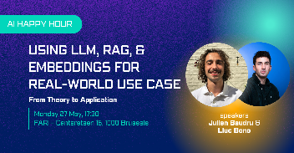
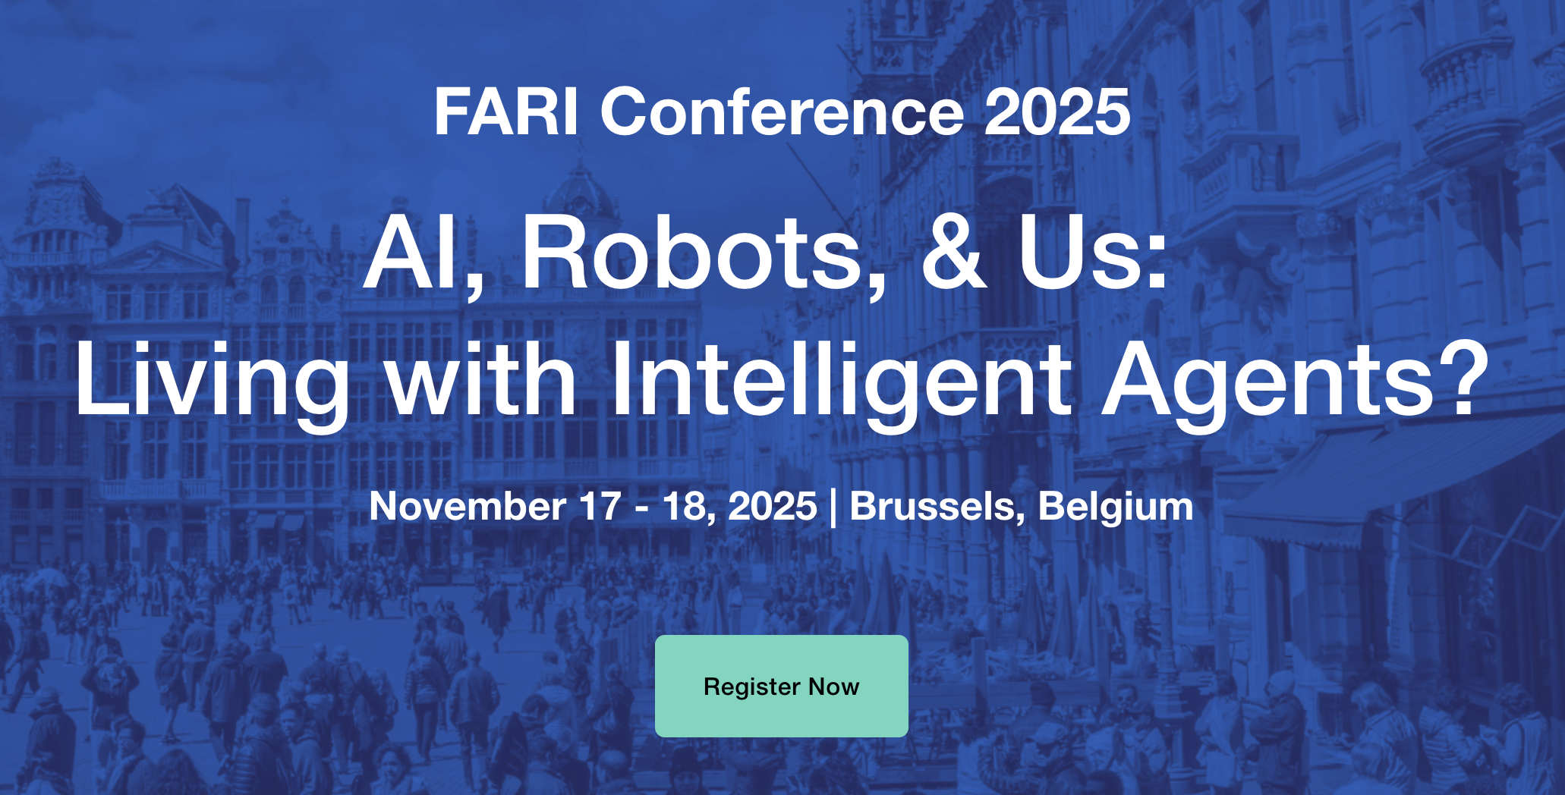
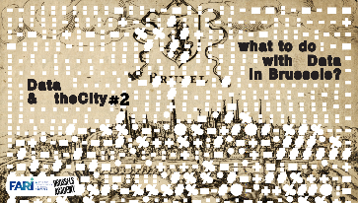
Engaging diverse actors: a conversation that matters

Slide 39
Citizen Engagement Hub Contribution (CEH)
CEH
Researchers
Guide, brainstorm, develop proposals, operationalize workshops to improve social readiness level of the research projects.
Civil Society
Inform, consult, involve, collaborate, empower by giving adapted expertise in AI, data and robotics.
Action
Network
Prospection
CEH + flagship
DIGITAL INCLUSION
AI & DEMOCRACY

Slide 40
Main FARI achievements & impact to date
Research and innovation
Education and Learning
Building a community of practice
12
New projects granted
6
Pilot projects
achieved
+3
Collaborative projects ongoing
6
Citizen science projects
2000+
People trained
+4000
People
100
Project based
training
10
Courses +
Postgraduate
program
15
15 PhD grants on AI for the Common Good
4
Postdocs on Sustainable Robotics, control or mobility
110
Events
10
Countries

Slide 41
Key infrastructure
The FARI Test and Experience Center (600m2)
A place where +15 demonstrations on AI, data, robotics and ethics showcase these technologies and their potential impact.
In this space, events are organized to meet private, public, civic and scientific actors.

Slide 42

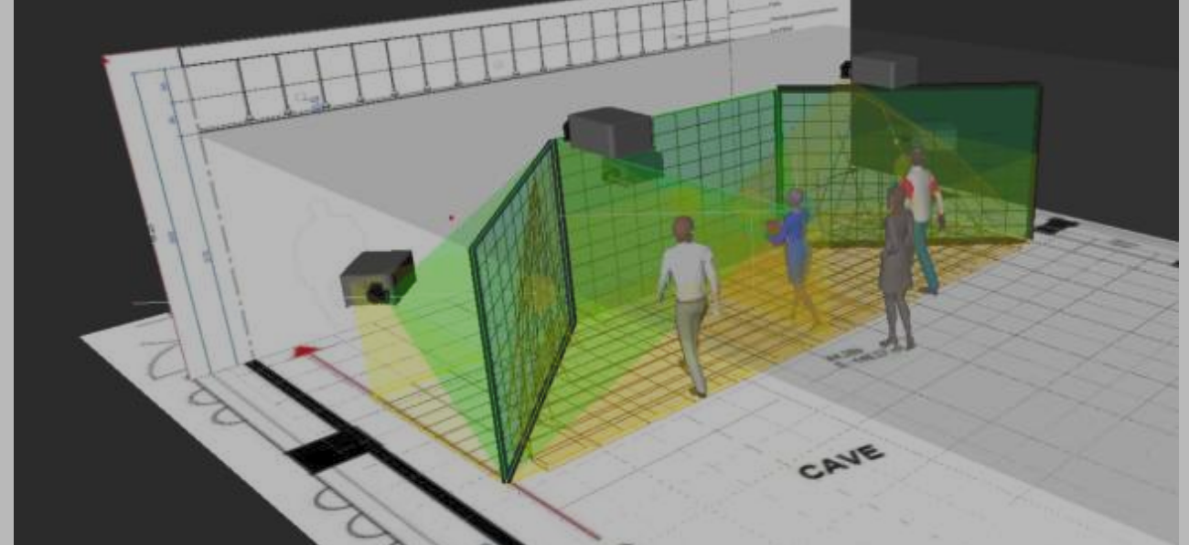
Our Computer Augmented Virtual Environment (CAVE)
Largest CAVE in Belgium: Our 147 sqm CAVE enables full-scale, immersive interactions that deliver insights beyond smaller setups.
4K BARCO Projectors: Three vertical and two floor screens let users walk through digital environments and engage from every angle.
Dual 4090 GPU Cluster: Equipped with two 4090 GPUs for real-time rendering of complex data and designs.
Real-Time Collaboration: Users can explore, manipulate, and interact with projects as if physically present in the virtual environment.

Slide 43
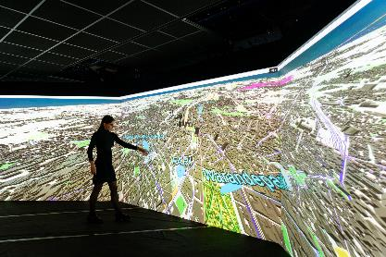
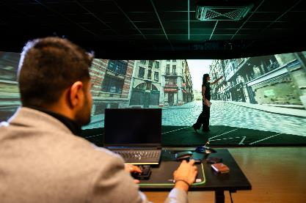

Slide 44
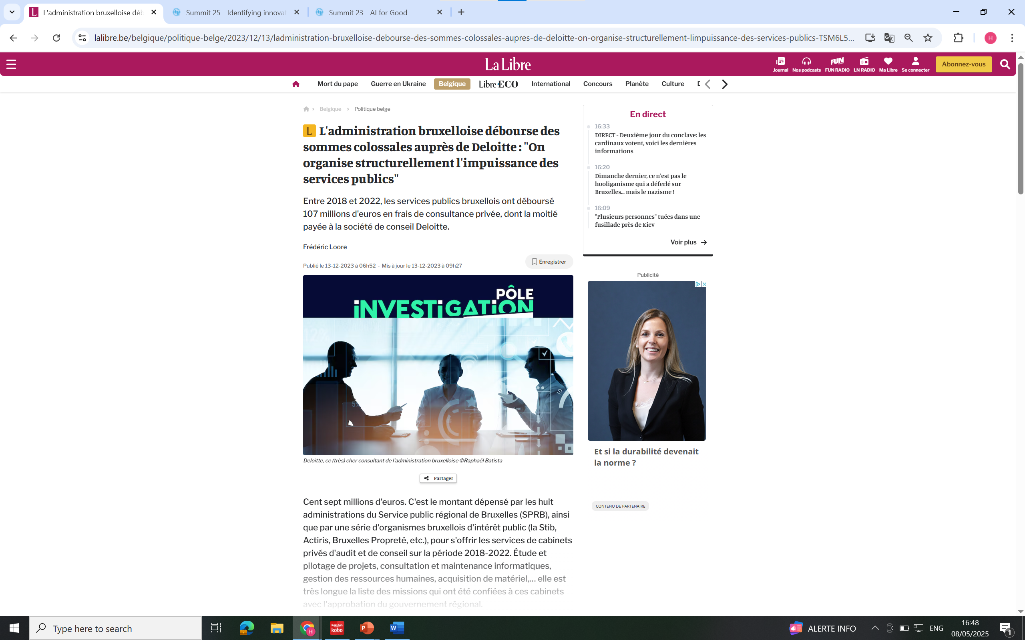

Slide 45


Conclusions

