Slide 1
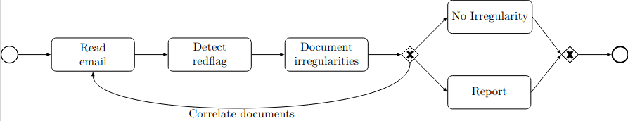

Regulatory Technologies (RegTech)
An emerging field of research

Slide 2
Plan of the talk
RegTech (emerging field of research)
Origin of RegTech
State of the art → insufficient (research & commercial)
Comparison with NLP
Current research at IRIDIA (processes, BPM, PAIS)

Slide 3
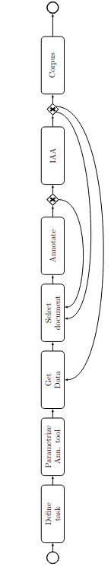
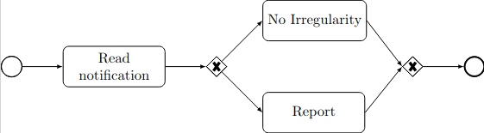
The emergence of RegTech ...

Slide 4
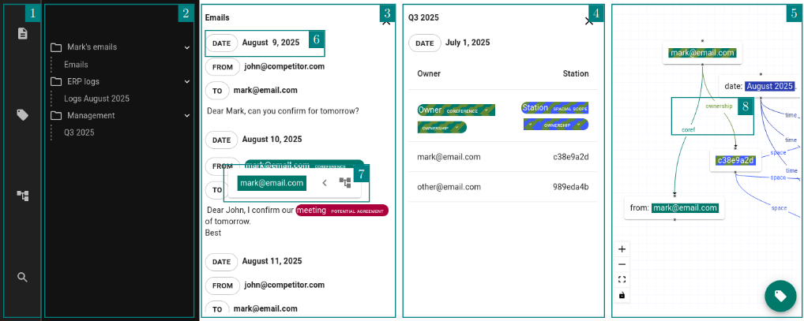
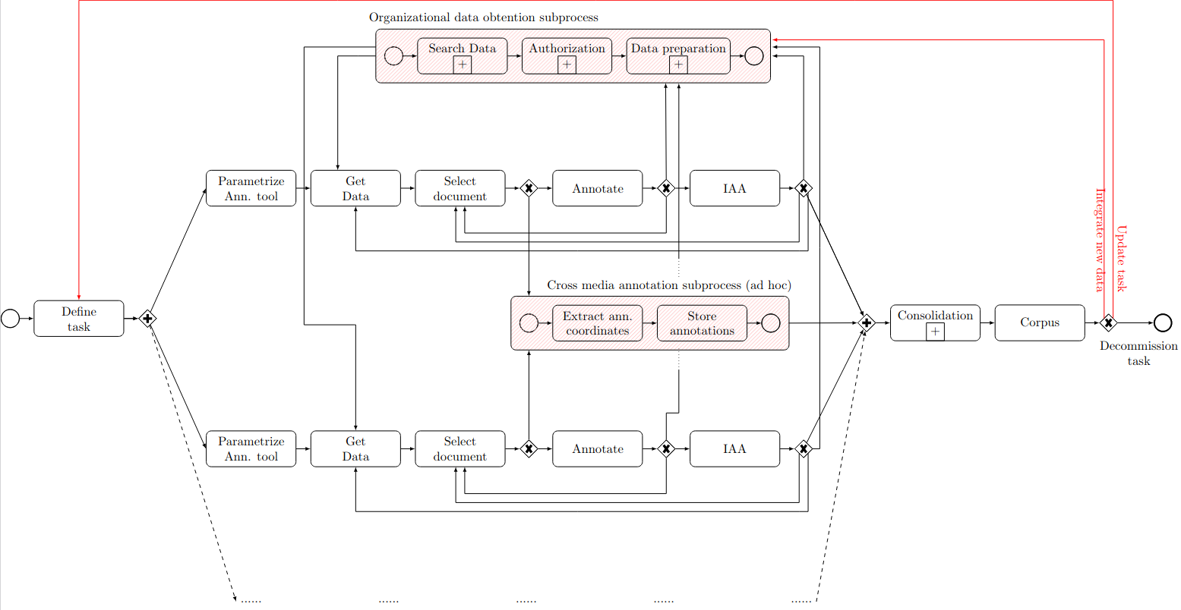
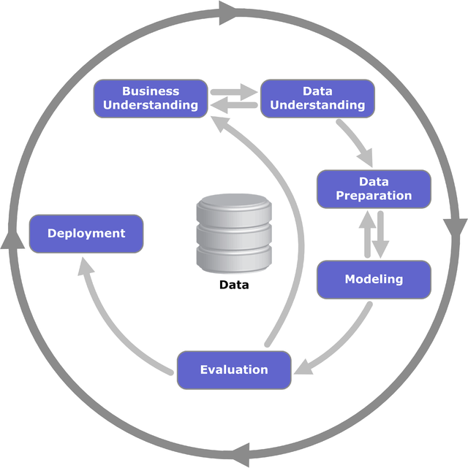
Guiding thread

Slide 5
The emergence of RegTech
From « ex post » to « ex ante ».

Slide 6
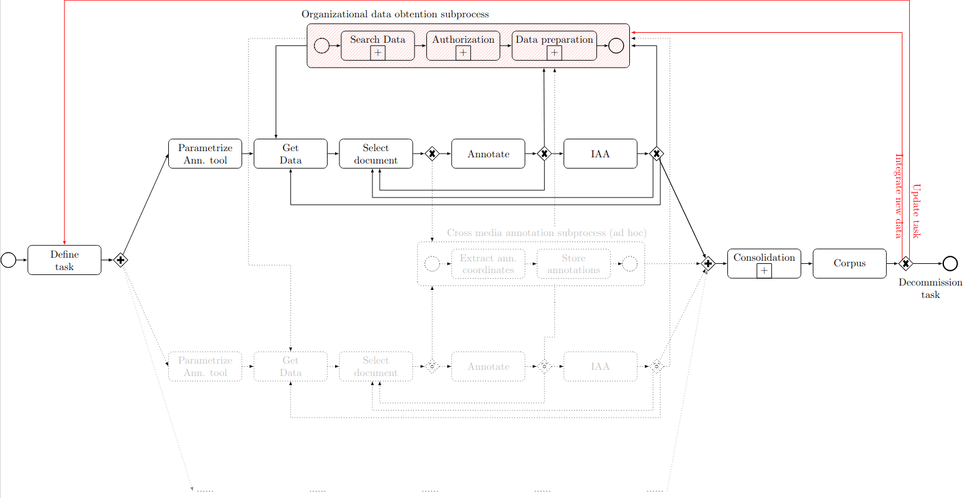
Courts : « ex post » solutions

Slide 7
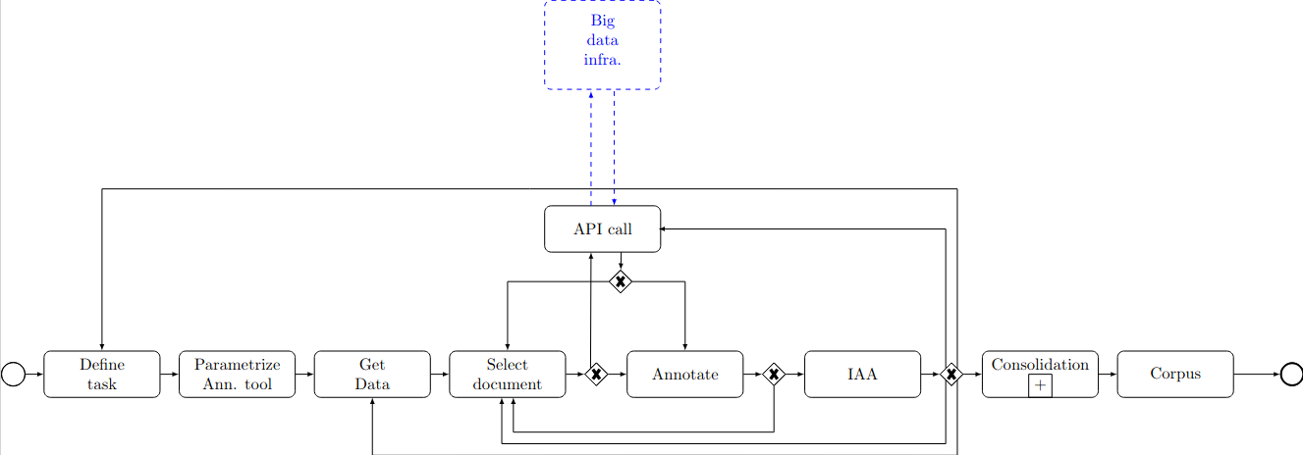
Algorithmic trading

Slide 8
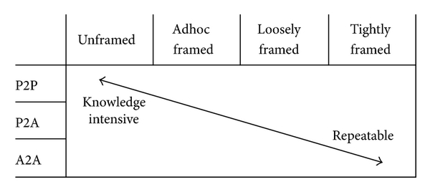
… and now what ?
Flash crash of May 6 2010 (DJI). Cause : Spoofing. Source : Wikipedia.

Slide 9
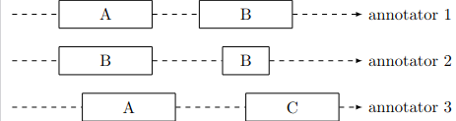
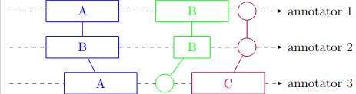
… and now what (2nd ed.) ?

Slide 10
« Ex ante » prudential approach
MiFID 2 (EU), Reg SCI (US), etc.
Biomed, food, etc.
AML, fraud, monitoring, etc.
European Artificial Intelligence Act
Standards (IEEE - P7003 standard 6, ISO/IEC TR 24027:2021)
Incentives : fines, business interruption

Slide 11
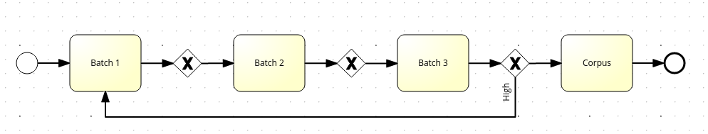
Non compliance can kill organizations

Slide 12
Plan of the talk
RegTech (emerging field of research)
Origin of RegTech
State of the art → insufficient (research & commercial)
Comparison with NLP
Current research at IRIDIA (processes, BPM, PAIS)

Slide 13
The State of the Art in RegTech ...
… as a business field

Slide 14
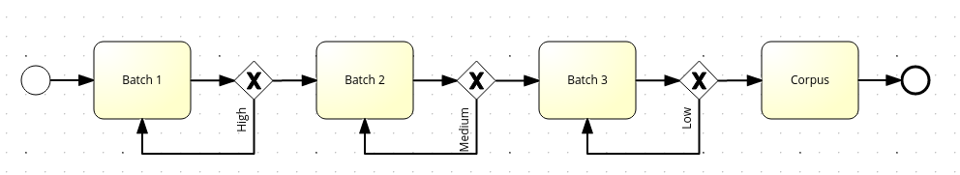

Slide 15
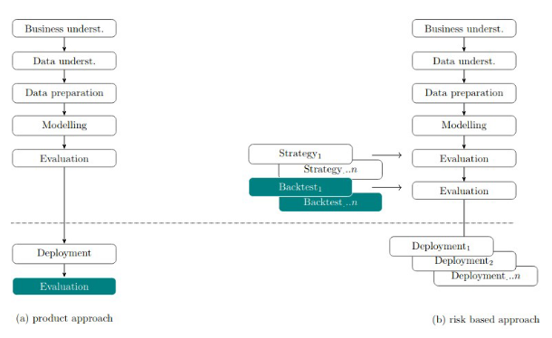
AML

Slide 16

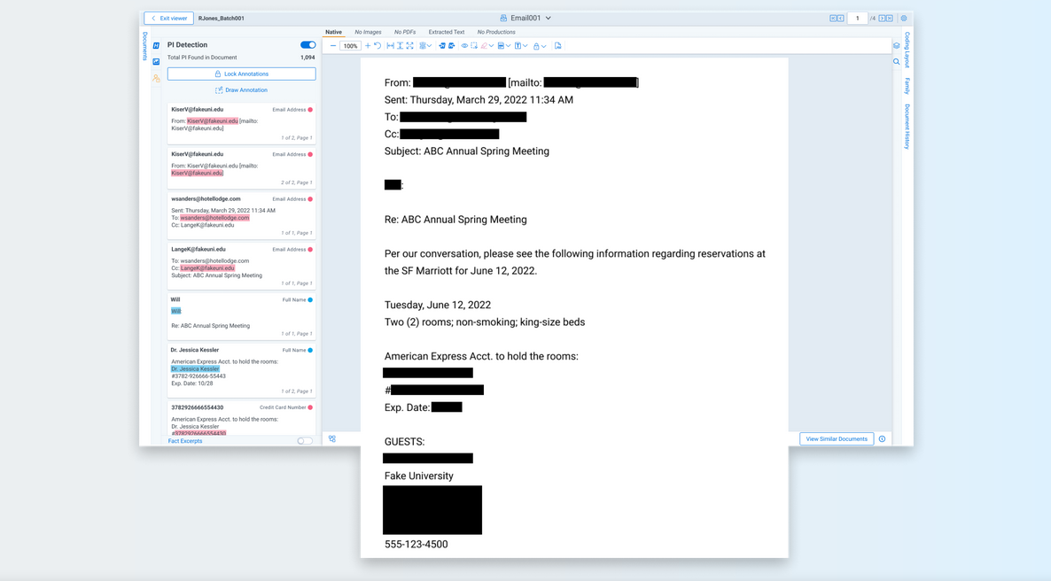
Privacy

Slide 17
Etc.
The list of business software is almost endless

Slide 18
The emergence of RegTech ...
… as a research field

Slide 19

Research’s conclusion
Commercial software (ex. Relativity Trace) (Butler & O’Brien, 2019).
Tower of Babel, no interoperability (Butler, 2017).
Duplication of work (Johansson et al., 2019, Nicoletti, 2017) and “spaghetti pots of code and data” (Butler, 2017).
Work remains essentially manual (Li et al., 2022; Chander et al., 2021).
Field of research is emerging (Becker et al., 2020; Y.-P. Yang & Tsang, 2018).

Slide 20
Sources of complexity (cumulatives)
A salient characteristic of RegTech is that it requires an
interdisciplinary approach (choregraphies) (Johansson et al., 2019; Kavuri & Milne, 2019) for
modeling complex (annotation) and non-stationary regulations (repetitions) (J. Li et al., 2023; Restrepo-Amariles & Lewkowicz, 2020; Arner, Barberis & Bukley, 2016) and
overseeing complex data (data heterogeneity) flows, including high volumes of data from disparate sources (CRM, ERP, emails, etc.) and siloed processes (big data), often in
real-time (benchmark) (J. Li et al., 2023; Haelterman, 2022; Papantoniou, 2022; Mahanti, 2021a; Al-Shabandar et al., 2019; Rashid, 2019; Anagnostopoulos, 2018).

Slide 21




OPP-115 (privacy policies, 2016)
115 annotated privacy policies
23.000 annotations, commercial software
pre-GDPR

Slide 22
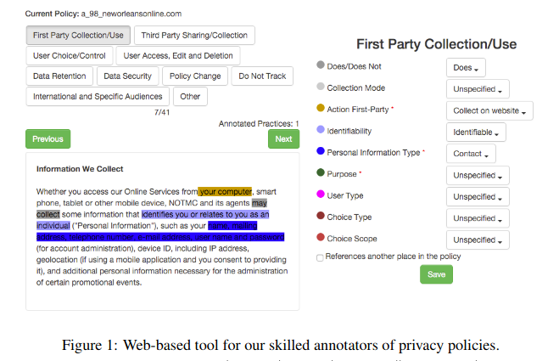
OPP-115 (privacy policies, 2016)

Slide 23
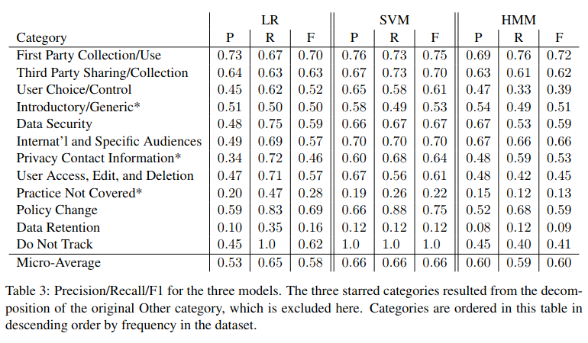
OPP-115 (privacy policies, 2016)

Slide 24
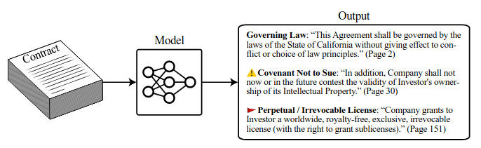

CUAD (NEURIPS, 2021)
13,000 annotations

Slide 25
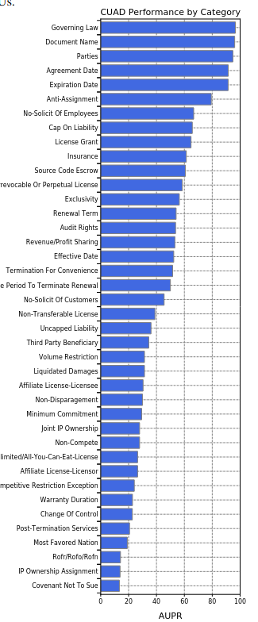
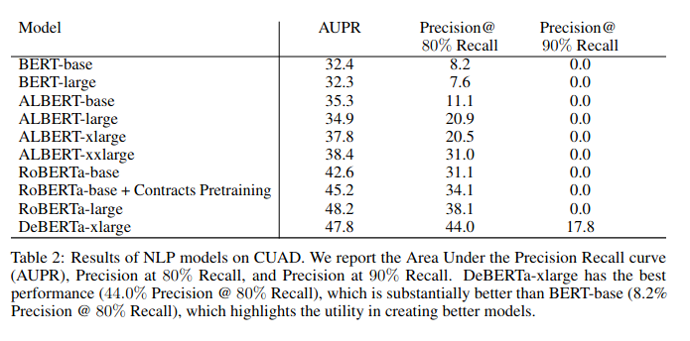
CUAD (NEURIPS, 2021)

Slide 26
GDPR120Q (ULB, 2023)
38.000 annotations
1. Document to Regulation (Formal and Substantial) Compliance, where the
compliance of a document is assessed against a regulation (here, the GDPR),
both in form and in substance.
2. Document Chain Compliance, where the documents are assessed against the
main contractual standards or against documents with a higher hierarchy in
the chain.
3. Operational compliance, which checks that the practice described in one or
more documents is actually carried out by the relevant stakeholder (i.e., data
is erased at the end of the data retention period).

Slide 27
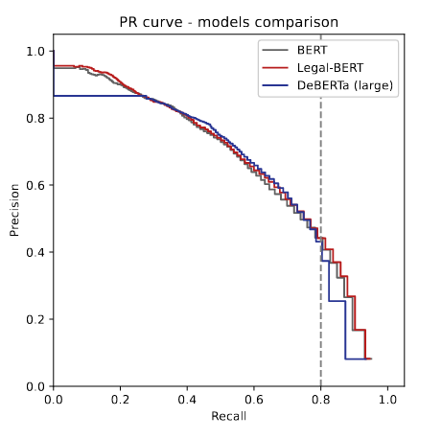
GDPR120Q (ULB, 2023)

Slide 28
Intermediary conclusion
Research & commercial soft. are progressing
Small research communities
Far from automation

Slide 29
What are the bottlenecks ?
Why do we have excellent NLP models and bad RegTech solutions ?
Why can we model proteins (AlphaFold) but not contracts ?

Slide 30
Do we have the right metric ?
Early scientific fields are often quite qualitative and become more quantitative as they mature. [...] the critical weakness is whether the metric actually, reliably tracks the property of interest, not the rigor with which the metric is evaluated (source : Reflections on Qualitative Research, https://transformer-circuits.pub/2024/qualitative-essay/index.html, Chris Olah, Adam Jermyn)

Slide 31

Objective of my research at
Find the right metrics for RegTech
Build the right tools for RegTech

Slide 32
Methodology
Let us start with what exists and works.
Find key differences.

Slide 33
Plan of the talk
RegTech (emerging field of research)
Origin of RegTech
State of the art → insufficient (research & commercial)
Comparison with NLP
Current research at IRIDIA (processes, BPM, PAIS)

Slide 34
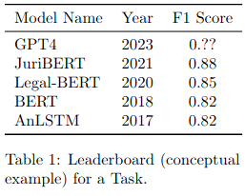
Benchmarks, CRISP-DM
Annotations

Slide 35
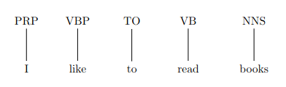
NLP example: task definition
eg. POS Tagging (NLP)

Slide 36
NLP example: get data
eg. articles of Wall Street Journal
preprocess

Slide 37
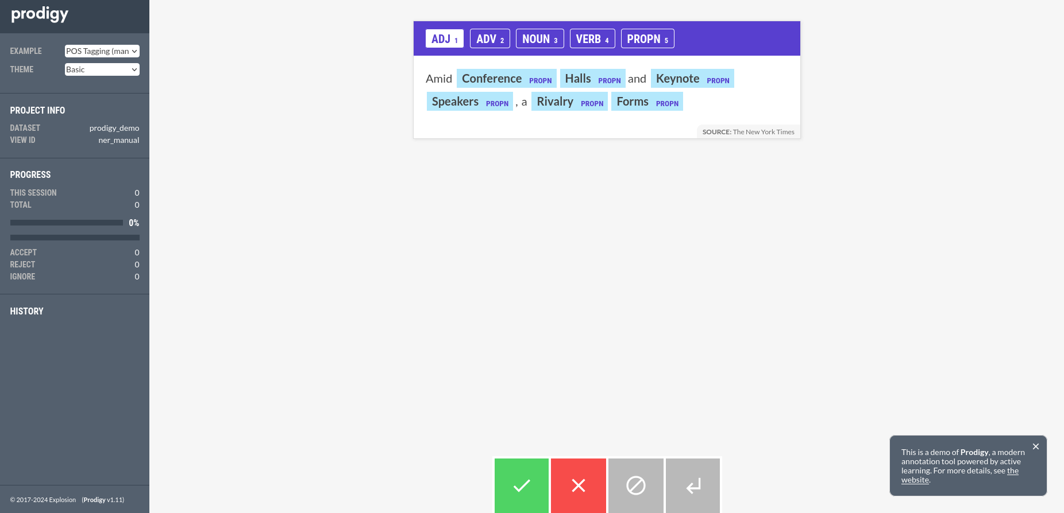
NLP example: annotate

Slide 38
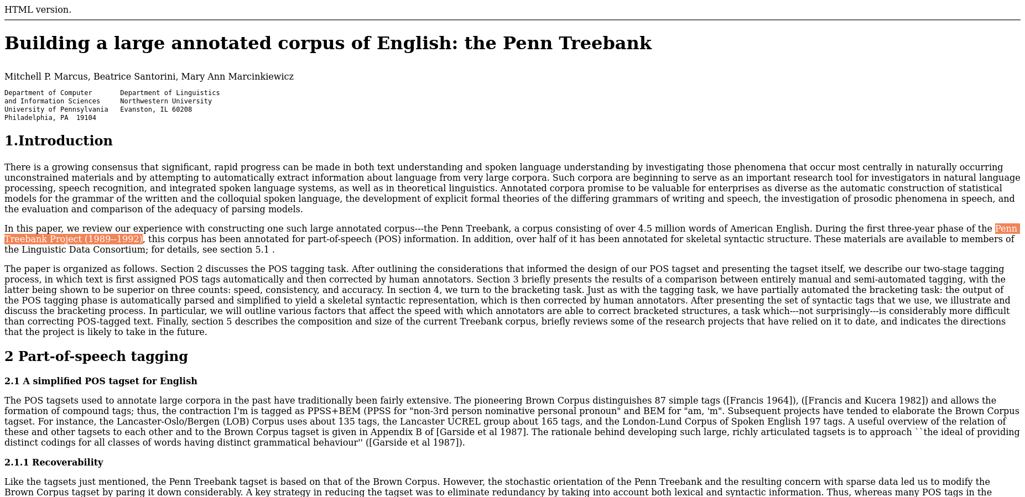
NLP example: publish corpus

Slide 39
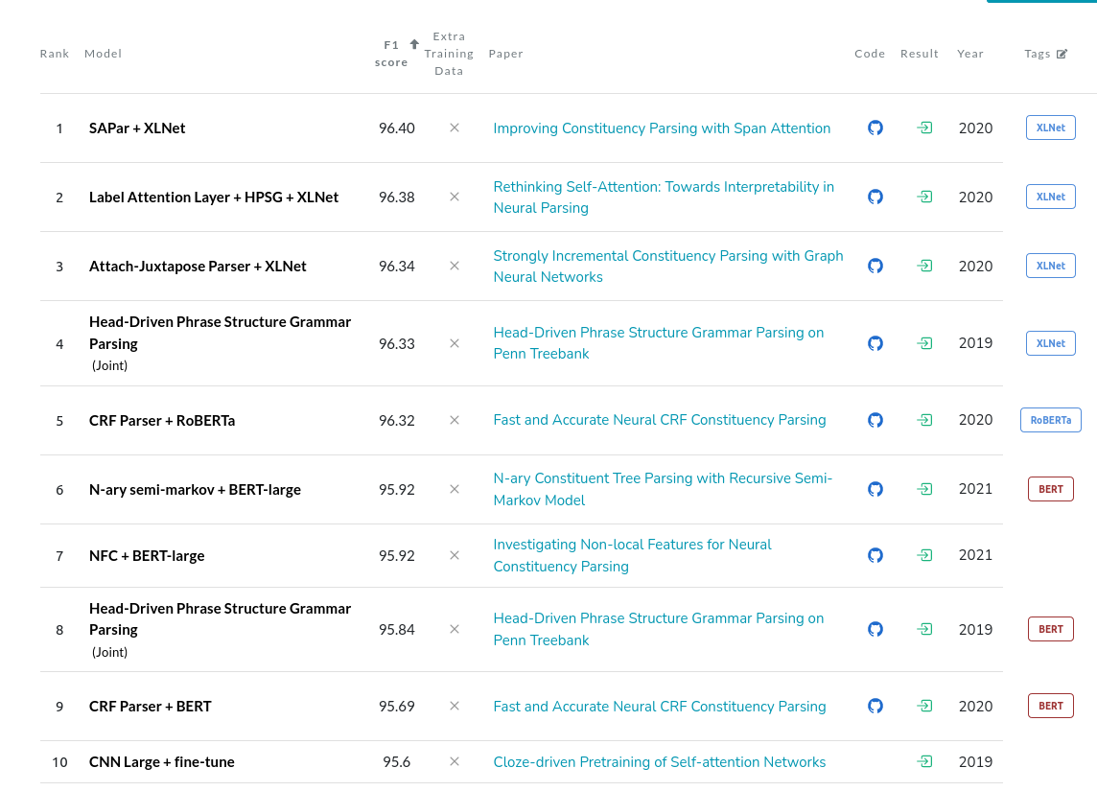
NLP example: develop models

Slide 40
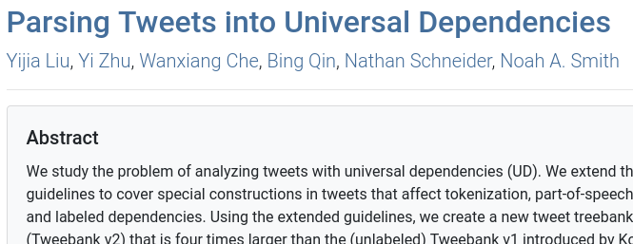
NLP example: repeat for new needs

Slide 41
NLP (working) example
Annotation
ML
Corpus
Train model
Publish

Slide 42
Plan of the talk
RegTech (emerging field of research)
Origin of RegTech
State of the art → insufficient (research & commercial)
Comparison with NLP
Current research at IRIDIA (processes, BPM, PAIS)

Slide 43
Transposition to RegTech
The problem of the processes’ complexity

Slide 44
Task definition
Document to Regulation, Document Chain compliance, Operational compliance
108 labels
Privacy policies, subcontracts, ERP, etc.

Slide 45
Document to Regulation
Download privacy policies

Slide 46

Document Chain compliance, Operational compliance
Databases, ERPs, etc.
Access
Authorization
Interoperability
We need a methodology for visualizing and handling business data

Slide 47
Big Data Infrastructures

Slide 48
Business process management (BPM)
BPMN notation to model the complexities of organizational processes
Helps modeling the complexities and bottlenecks
Helps simplifying processes
Helps building process aware information systems (PAIS)

Slide 49
BPMN, PAIS
Manual process
Automated process

Slide 50
Already seen above in the NLP example
Annotation
ML
Corpus
Model
Publish

Slide 51
Compliance annotation process with NLP tools

Slide 52
Ant handles heterogenous data

Slide 53
Ant’s API (interoperability with Big Data infrastructures)

Slide 54
Ant : conclusion
April-may 2022, 150+ students, 98.000+ annotations
Oct.-dec. 2022, GDPR120Q, 38.000+ annotations
Nov.-dec. 2022, Simplex, 8.000+ annotations

Slide 55
Inter-annotator agreement
Span selection, labelling & linking
Sota = polynomial complexity (Mathet et al. 2015, 2017)

Slide 56
Process
PAIS IAA
No IAA

Slide 57
This is only the start (quants, AI Act)

Slide 58
Conclusion
Emerging field of research
Problem = DS/ML AND BPM
In compliance the ML process is identical but the organizational process here it is performed is totally different
Priority : PAIS to include lawyers systematically in the processes

