Slide 1
Introduction to Deep learning
A bit of Theory and applications

Slide 2
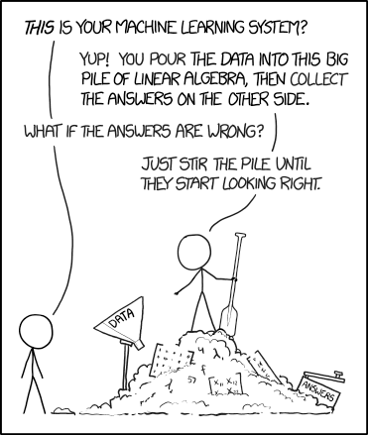
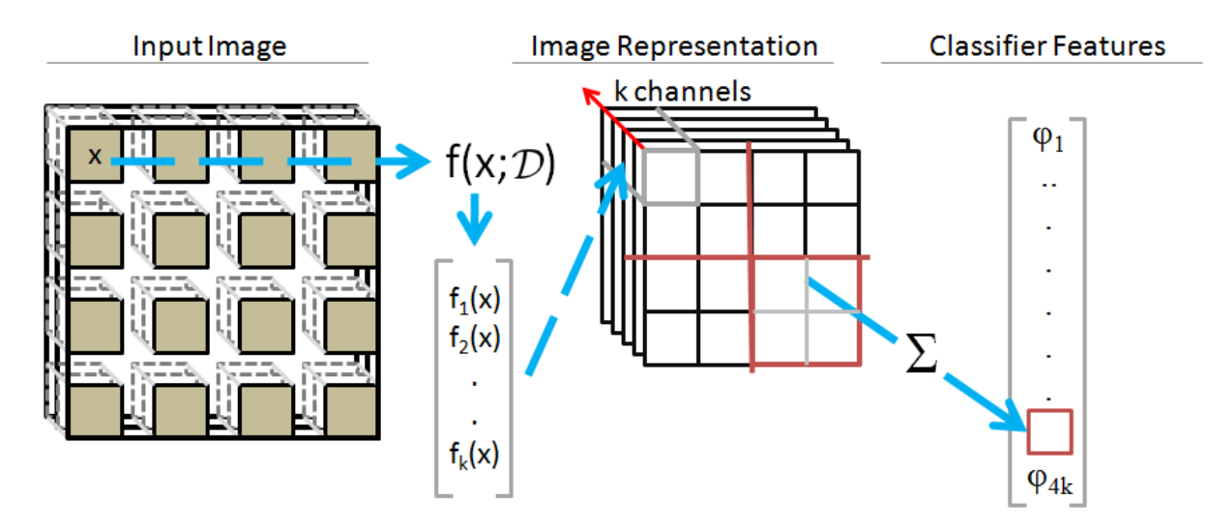
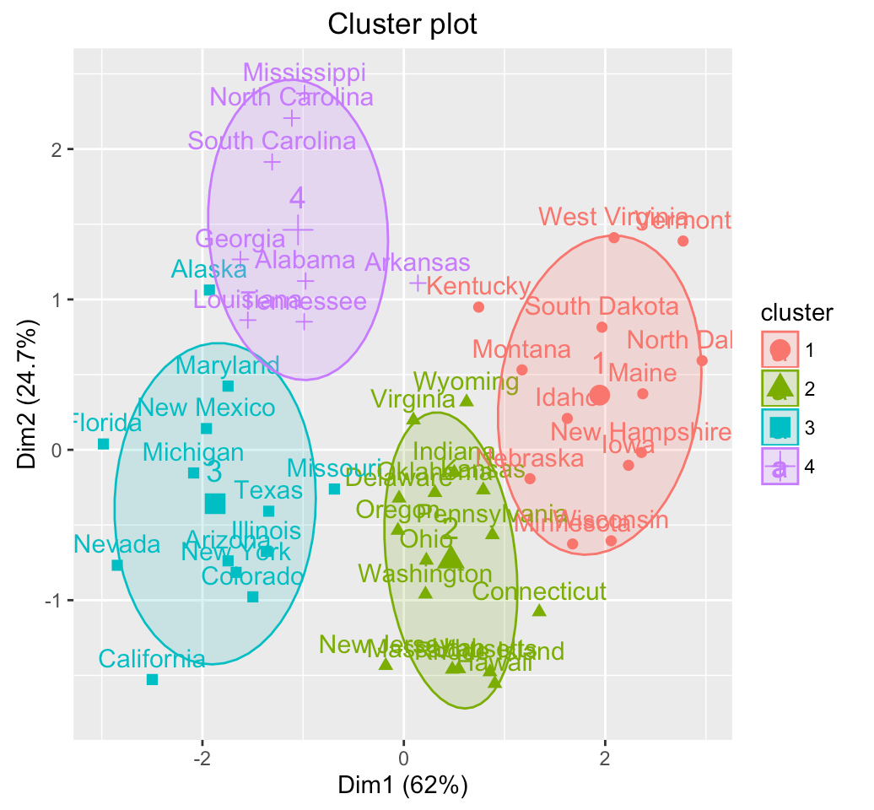
What is deep learning?
What is the difference between NN and DL?
Is deep learning dependent on NN?
Coates, Adam, and Andrew Y. Ng. "Learning feature representations with k-means." Neural networks: Tricks of the trade. Springer, Berlin, Heidelberg, 2012. 561-580.
Notes:
For most data scientist out there they believe that machine learning more specifically Deep learning is just a blackbox that you can throw your data in and get your results on the other side.
Question the students: Does any one know what is the difference …
If you want to know more about Deep learning architectures that do not use NN as their core please refer to the citation below

Slide 3
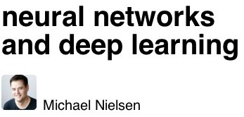
A good place to start
https://github.com/floodsung/Deep-Learning-Papers-Reading-Roadmap
https://gist.github.com/allanbian1017/33a594a61a47222faf40c908ee1c7518
Notes:
Here I just want to show you some pointers where to start to learn Deep Learning
In the following set of slides we will talk about the Deep Learning in the context of Neural Networks. The slide at the beginning was to show you that you do really need NN to use DeepLearning.

Slide 4
Deep Learning architecture
Deep Learning & Neural networks are treated as synonyms: However is generally described as:
“Allow computers to learn from experience and understand the world in terms of a hierarchy of concepts, with each concept defined in terms of its relation to simpler concepts”
Fully connected network
1 Input layer
2 Hidden layers
1 Output layer
Deep Learning is a powerful set of techniques that allow us to learn Neural Networks
Notes:
Some you may already know what Deep learning is. However, I would like to refresh you mind first and later to explain how NN network came to be part of the Deep Learning setting
Intuitively, each computational unit tries to learn a specific characteristic about their input. Connections between input and output units are represented as weights expressing the importance of the respective inputs to the outputs. As a result, computational units can be thought as a small-scale system that makes decisions by weighing up evidence

Slide 5
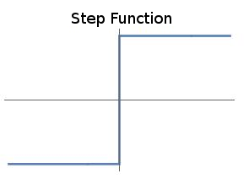
Perceptron
$$w⋅x= \sum_{i=1}^{n}{w_{i} ∗x_{i}}=w_{1}x_{1}+ …+w_{n}x_{n}$$
Bias: is a measure of how easy it is to get the perceptron to fire
Notes:
You might have heard from a perceptron. It the most primitive part of a neural net and can be considered as a binary classifier or linear classifier.
The binary activation of a perceptron can be represented in two ways. Through a threshold on top or through a bias .
For a perceptron with a really big bias, it's extremely easy for the perceptron to output a 1. But if the bias is very negative, then it's difficult for the perceptron to output a 1.
I perceive perceptron's as a method for weighing evidence to make decisions

Slide 6
Multi-Perceptron
Modify the weight $w_{i}$ and biases $b_{i}$ to
Change the outputs decisions $o_{k}$
Small changes in any weight or bias causes small changes in the output
$$w+wΔ ;b+bΔ →o+oΔ$$
Notes:
First layer makes very simple decisions. These decisions are then propagated to the second layer which weights up the results of the first layer making these units come up with more complex and abstract decisions. This goes on layer by layer (hidden layers) until the last layer (output layer) makes the final decision. From this workflow we can deduce that decisions on the first and hidden layers can affect the decisions of the output layer. Consequently, we can willingly modify the weights and biases of the other layers until we get the desired output
In a perceptron, a single change of a weight and a bias can completely change the outcome of the output layer. This may be very dangerous if we were to use this model to classify if some one has cancer or not.
What would be more interesting is to let units of the network to make slight changes on the weights and biases so the decisions do not change so drastrically. Luckily for us there is a linear interaction between the changes on the weights and biases and the output of the network

Slide 7
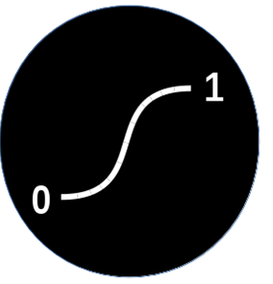
Neural Networks activation functions
smooth
$$\frac{1}{1+e^{−z}}$$
$$tanh⁡(z)$$
$$z=w⋅x+b$$
Notes:
From here onwards we depart from the perceptron activations and move toward Neural Networks activations. Don’t let the math here to intimidate you. We previously saw before that if you modify the weigths of a perceptron, one single change can completely change the outcome in the output units. In order to change the weights and biases more smoothly we have to smooth the perceptron activation function.
Meaning is just passing the step function in to a smoothing function.

Slide 8
Neural Networks activation functions
Previously: $w+wΔ ;b+bΔ →o+oΔ$
We can write this as:
$$Δoutput≈\sum_{j}{\frac{∂output}{∂w_{j}}Δw_{j}+\frac{∂output}{∂b_{j}}Δb_{j}}$$
$$\frac{1}{1+e^{−z}}$$
$$tanh⁡(z)$$
$$z=w⋅x+b$$
Notes:
where the sum is over all the weights, wj, and ∂output/∂wj and ∂output/∂b denote partial derivatives of the output with respect to wj and b
Δoutput is a linear function of the changes Δwj and Δb in the weights and bias. This linearity makes it easy to choose small changes in the weights and biases to achieve any desired small change in the output

Slide 9
How NN learn $w_{i}$ and $b_{i}$?
$$h_{\left(w,b\right)}(x)$$
Find an objective and quantify it
Compare you hypothesis with the real results ( supervised learning)
Find patterns in the data, build a hypothesis and check if it matches the dynamics of your problem (unsupervised)
Cost Functions:
$$y(x)$$
Name | Cost function
Mean Square Error (MSE) | $$\frac{1}{2n}∑{\left\|h_{\left(w,b\right)}\left(x\right)−y\left(x\right)\right\|}^{2}$$
Cross-Entropy | $$−\sum{[y\left(x\right)\ln\left(h_{\left(w,b\right)}\left(x\right)\right)+(1−y\left(x\right))\ln\left(1−h_{\left(w,b\right)}\left(x\right)\right)]}$$
Kullback–Leibler divergence | $$\sum_{x}{y\left(x\right)\log{\frac{y(x)}{h_{\left(w,b\right)}}}}$$
Picture: http://selmandesign.com/qa-on-machine-learning/, [01/04/2018]
Notes:
To learn the weights and biases of every layer in a network we need to first set its objective to approximate the output 𝑦(𝑥) for all training inputs 𝑥.
For instance our objective can be to classify whether a patient has cancer or not.
This objective can be quantified by means of cost functions as shown in the following table
Again do be afraid of the math this simply state that you should measure the error you your hypothesis with the real outcomes. This is an indication to the neural network that the hypothesis is incorrect and it needs to be changed.

Slide 10
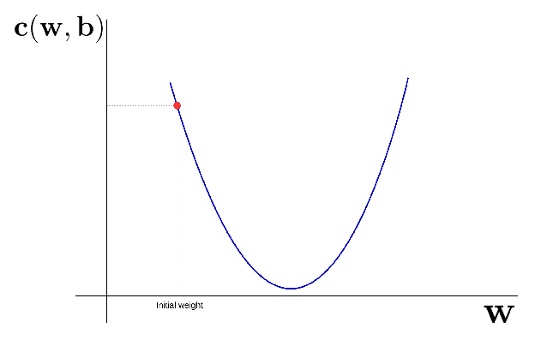
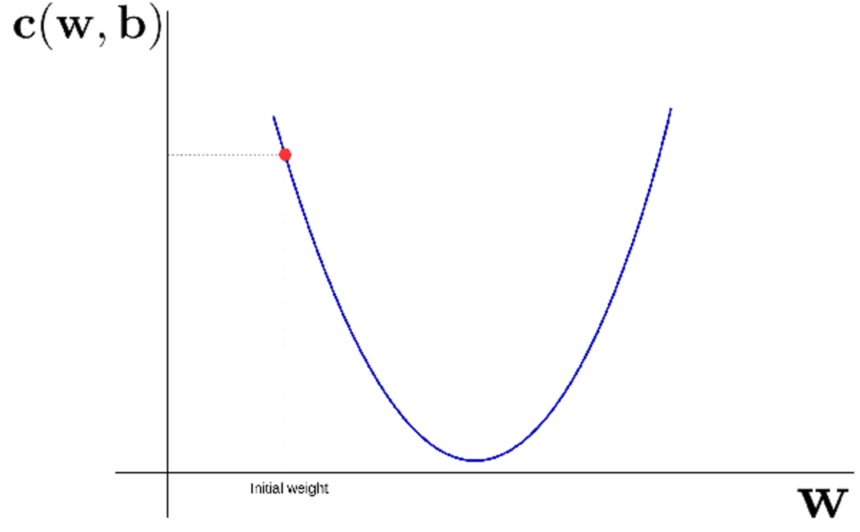
How NN learn $w_{i}$ and $b_{i}$?
Minimise the cost $c(w,b)$ as a function of the weights and biases.
Gradient descent:
How propagate the error to all $w$ and $b$
How much to change $w$ and $b$ so it takes positive effect on the decisions of the outputs
Changes on $w$
$$Δw=−α ΔC(w,b)$$
Notes:
Now that we have a way to quantify our objectives (cost function) we need to ask two questions:
how are we going to propagate this information to the weights and biases of the network.
If we manage to propagate them how do the weigths and biases know how much do they need to change
Let us answer the second question first and then we will answer the first question in the next slide.
Our objective is to weights and biases which make the cost as small as possible. We'll do that using an algorithm known as gradient descent.
Let us see how gradient descent works. In this plot we have the cost generated by w and b. on the x axis we have the possible values of w (Click to show eq)
Here basically we are computing the derivative or the slope at this point. And then we say that the direction of the change should be towards the negative direction of the slope. How much to change on that direction is specify by alpha. Which is called the learning rate Let see how this works. (Click to start the gif)

Slide 11
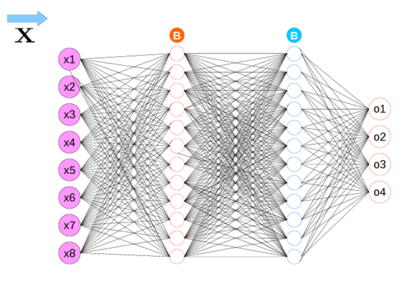
Backpropagation
$$ΔC=(a_{j}^{L} −y_{j})$$
$$δ^{l}=\left(a^{l} −y \right) ⊙σ′(z^{l})$$
$$δ^{l}=\left({\left(w^{l+1}\right)}^{T}δ^{l+1}\right)⊙σ′(z^{l})$$
$$\frac{∂C}{∂b^{l}}=δ_{j}^{l}$$
$$\frac{∂C}{∂w_{ij}}=a_{k}^{l−1}δ_{j}^{l}$$
Notes:
Before I show you in a gif how the back propagation works. I would like to briefly explain you some of the equations that you will see in the gif.
This first function how we compute the “derivative” of the cost in the output layer. It is just simply hypothesis and real values as we saw in the diet coke example
The second function is the cost at the layer before the output layer. Here we can see is the element wise multiplication between the cost change and the derivative of the activation function of the current layer
The third one is the cost of every layer that comes before the second layer.
Don’t pay much attention to the other two in the bottom as thet are the if you want to compute the change of the cost with respect of weight and bias ( click for gif)

Slide 12
Backpropagation assumptions
Use Gradient descent in Networks?
Back propagation
Layer Weighted-input
$$z^{l}=w^{l}{ a}^{l−1}+b^{l}$$
Layer Activation
$$a^{l}=σ(z^{l})$$
Assumptions for the cost:
Cost functions have to be written as an average over cost functions. $C= \frac{1}{n}\sum_{x}{C_{x}}$ where $c_{x}$ is the cost of a single training example $C_{x}=\frac{1}{2}{\left\|y −a^{l}\right\|}^{2}$
Cost functions have to be written as a function of the outputs from the NN $C\left(a^{l}\right)= \frac{1}{2}{\left\|y −a^{l}\right\|}^{2}$
Friendly tutorial of gradient descent: http://sebastianruder.com/optimizing-gradient-descent/
Notes:
This slide is just to tell you that you dont have to use all the cost functions that I show you before. You can use any function that you want as soon it follows this two assumptions
The first assumption its that we can write the total cost as a sum over cost functions.
The second assumption is that you cost function as function of the outputs only. We saw in the back propagation part that every time we compute the cost is in function of the outputs of each layer.

Slide 13
Convolutional Neural networks

Slide 14
Convolutional Neural networks
They are excellent for input spaces that have an spatial or temporal ordering.
Images
Videos
They are used to exploit the spatial information that exist in the data.
Fully connected: two pixels far apart are treated the same.
The concept of share weights is introduced.
Introduces rotation and translation invariance
Scale invariance: Capsule Networks. Sabour, Sara, Nicholas Frosst, and Geoffrey E. Hinton. "Dynamic routing between capsules." Advances in Neural Information Processing Systems. 2017.

Slide 15
Convolutional Networks
Notes:
Next one will be? => 71

Slide 16
Convolutional Networks

Slide 17
Convolutional Networks
Notes:
Can anyone guess what would be the activation after convolution

Slide 18
Convolutional Networks

Slide 19
Convolutional Networks

Slide 20
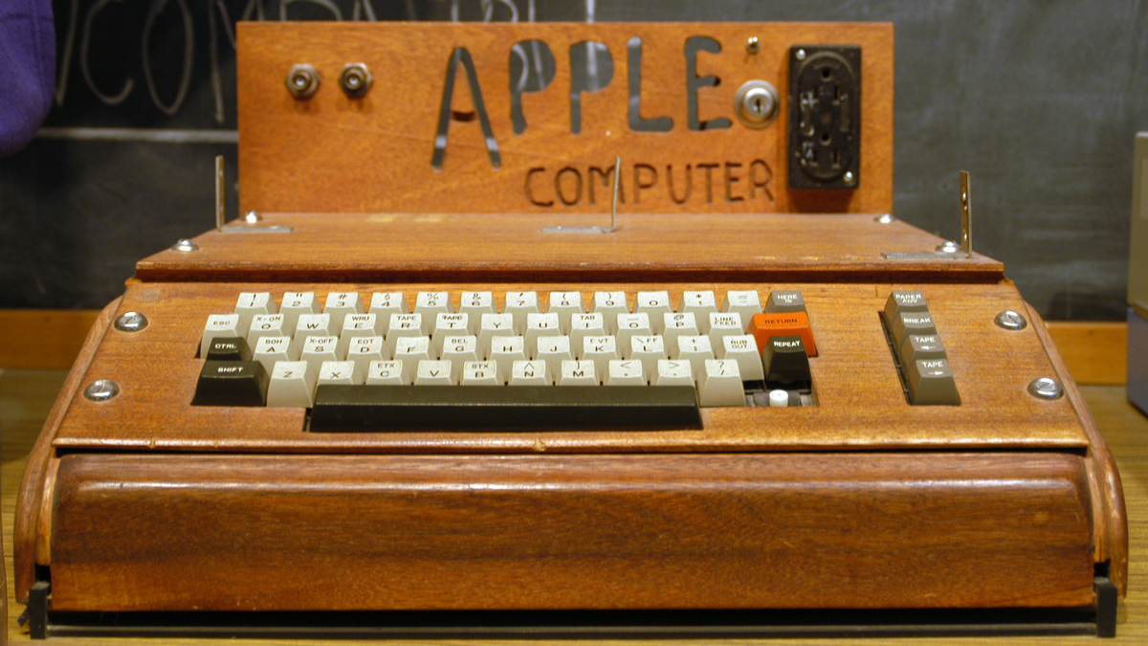
Old techniques.
Learning
Learning Models:
Multi-layer perceptrons (Werbos,1982 and others)
Convolutional nets (LeCunn et al, 1998)s
Autoencoders (Bourlard & Kamp, 1988)
Energy based models/ RBMs (Smolensky, 1986)
LSTMs (Hochreiter&Schmidhuber,1997)
Training
Training techniques:
Backpropagation (Linnainmaa, 1970 and others)

Slide 21
Deep Learning hype

Slide 22
Breakthrough

Slide 23
Breakthrough
What happen here with Neural Netwoks

Slide 24
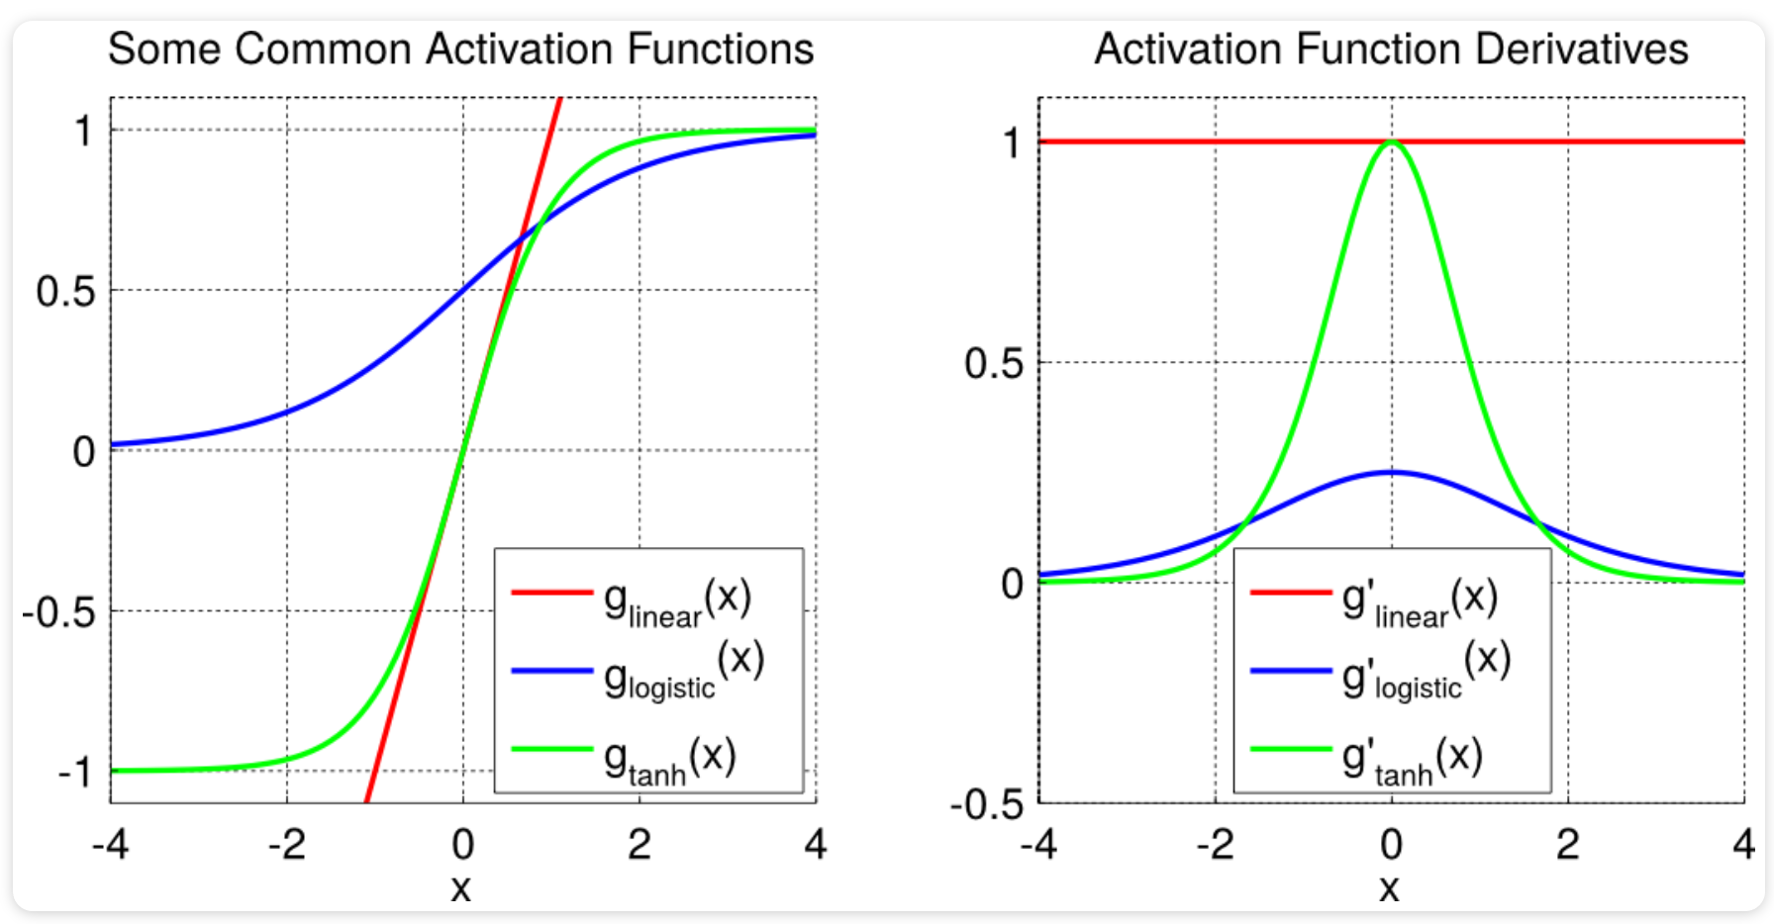
Vanishing and exploding gradients
When you train very deep neural networks the derivative or slopes of your network can either get very small or very big
Previously the NN did not work because they where suffering from this problem. Specially due to the activation function that they use
Notes:
Peiters notes

Slide 25
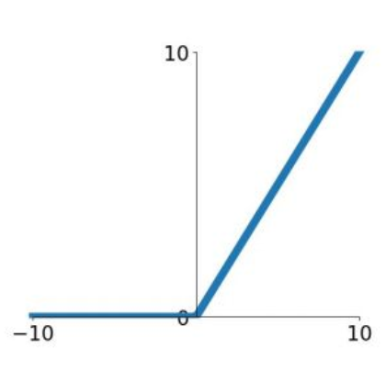
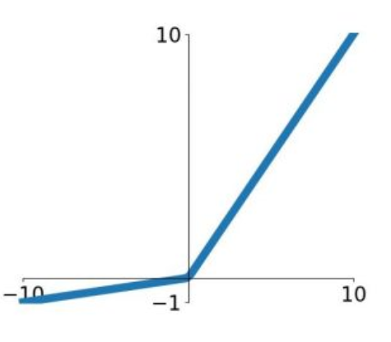
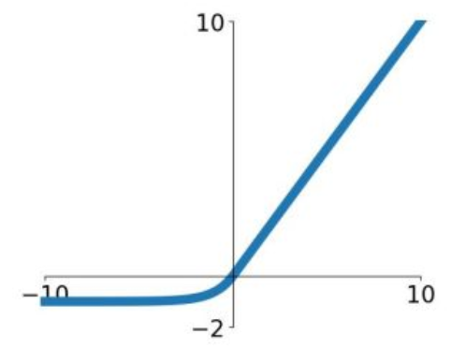
So why does deep learning work now?
Better Activation Functions
ReLu
Leaky Relu
ELU
$$max⁡(0,x)$$
$$\left\{\begin{aligned}&x, x<0 \\ &α(e^{x}−1), x≥0\end{aligned}\right.$$
$$max⁡(0.1x,x)$$

Slide 26
So why does deep learning work now?
Better regularisation techniques
Dropout (Srivastava, et al., 2014)
Prevents coadaptation of neurons
Potential measure of uncertainty
Batch-layer normalisation (loffe & segedy, 2015)
Keep statistics over batches to normalise activations
Eliminate covariance shifts. (Changes in the underline distribution due to batches)

Slide 27
So why does deep learning work now?
Better update techniques
Adam (Kingman & Ba, 2014)
Adagrad (Duchy et al., 2011)
Adadelta (Zeiler, 2012)
RMSProp (Tieleman & Hinton, 2012)
Contrastive Divergence for RBMs (Hinton, 2002)

Slide 28
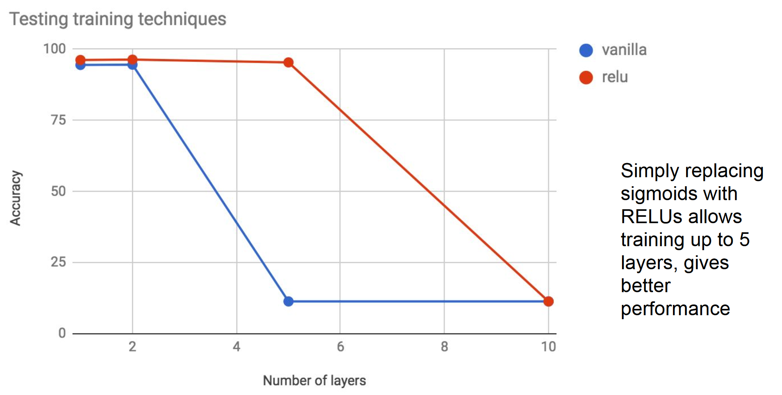
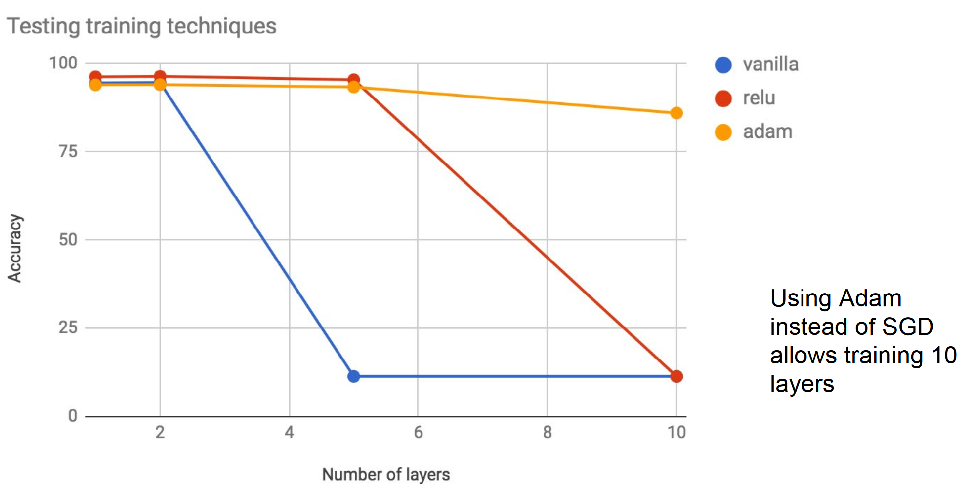
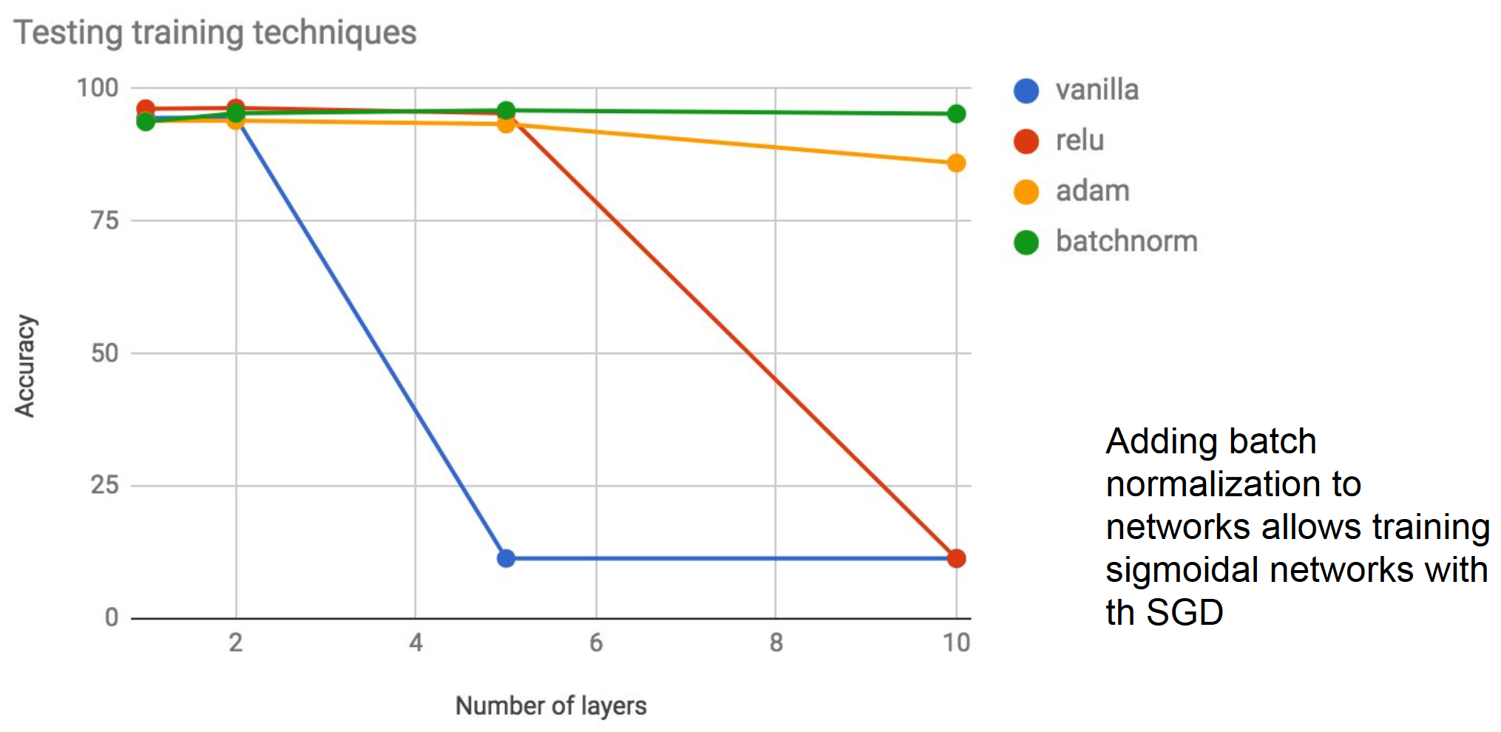
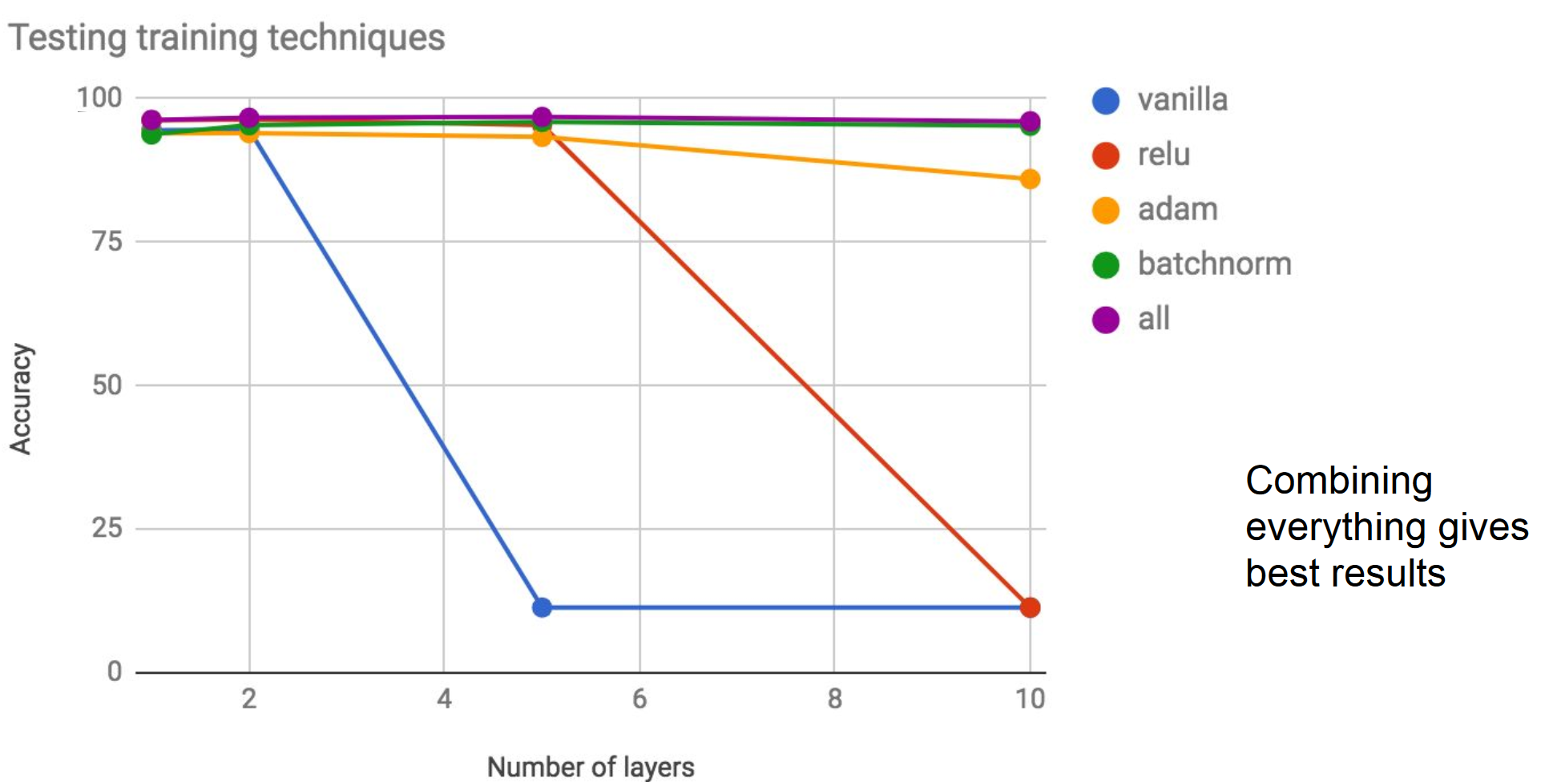
Pictures provided by Prof: Peter Vrancx

Slide 29
Applications
Deep Learning

Slide 30
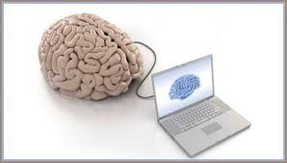
AMP-Foot (robotics)
DL

Slide 32
Art

Slide 33
Complicated games (partly)

